Slide 1

Primary Teacher
Resource Pack

Slide 2
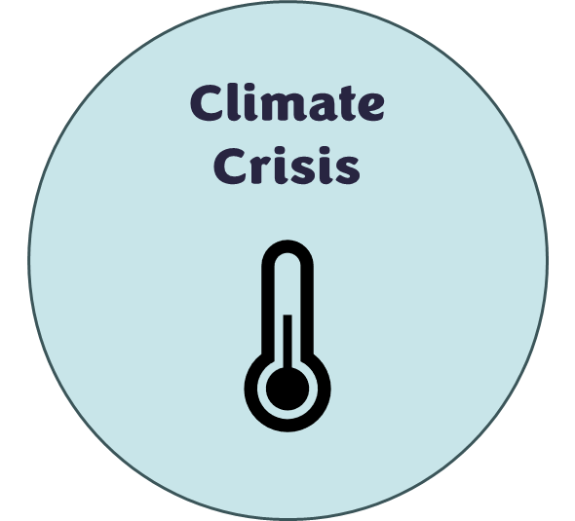
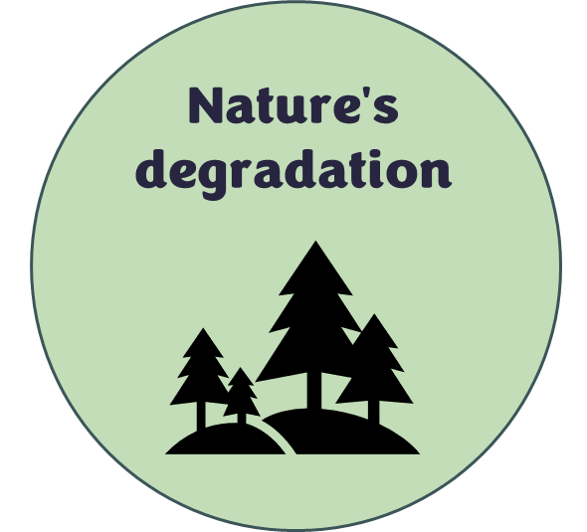

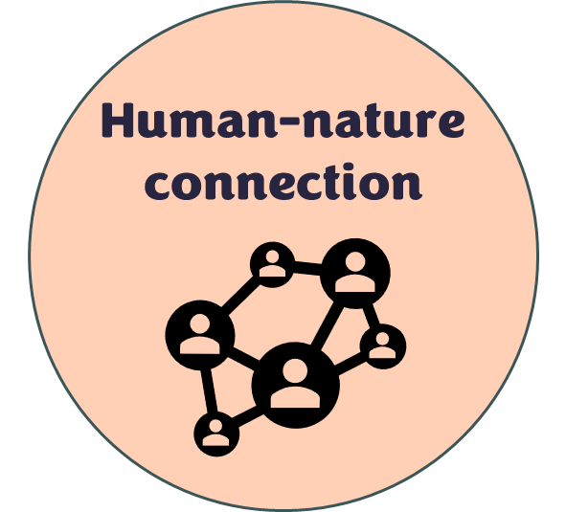

Introduction
What is Earth Stories?
  Earth Stories Film Festival is an award-winning, environmental film festival providing a platform for young filmmakers under the age of 25, from across the world to articulate their concerns around the climate crisis. The festival is organised by Keele University students supported by Media staff. Earth Stories is a beacon of hope, presenting inspirational stories through the medium of film addressing the climate crisis, nature's degradation, and highlighting pathways for a more sustainable future.
  Earth Stories has developed a series of lesson plans to encourage young people in the local area to think sustainably about the climate crisis, with the hope that students will take the opportunity to create a short film between 1 and 10 minutes to submit to Earth Stories Film Festival 2025 under the new category “Local Filmmaker”.
  You can watch the 2025 Award Ceremony, and the nominated films from 2023, 2024 and 2025, on our YouTube channel at “Earth Stories Film Festival”.
  Visit the website https://www.keele.ac.uk/earth-stories/ to find more information and links to social media channels.
About the resource pack
  This pack includes lesson plans and activity sheets (including answers where necessary) for winning or shortlisted films from past festival entries.
  All lesson plans include links to the English national curriculum, key vocabulary, a resource list and careers links. Links have also been made to the United Nations Sustainable Development Goals and to UNESCO’s eight key competencies for sustainability.
  We have also included an Earth Guardian sticker log and certificate to encourage students to explore all the themes and create an entry for the 2026 festival. Lesson plans have been mapped to include each of the themes – look for the icons.
  Advice from Explorify: ‘When teaching children about the Climate Challenge, it is important that we give them the facts (age appropriately and sensitively). During your discussions, allow time for children to express their thoughts and feelings and have them validated.’ For more information about how to teach students about the climate challenge go to Are you ready to meet the 'Climate Challenge?' Part 2 - Explorify
  Tips and tricks for filming, storyboard examples and a storyboard template have also been included.
  All the films in this pack can be accessed here: Primary Resource - YouTube

Slide 3
About the filmmakers
Saving Littlejohn
Directed by Mhairi Fenton
Age 25
United Kingdom.
Special Mention Prize 2023
“Originally from an art background, I have moved from environmental art to becoming a wildlife cinematographer. I believe science and art are not two distinct disciplines, rather they are different methods of understanding the world and expressing research. Wildlife documentaries are at one of the intersections converging research and expression.”
The Littlejohn tree frog is currently listed as vulnerable under the Environment Protection and Biodiversity Conservation Act 1999. In this documentary, we see the hidden lives of The Littlejohn's Tree Frogs and the three scientists determined to save them. Dr Michael Mahony accounts their Past, Dr Alex Callen is saving the Present and Dr Rose Upton is securing their Future.
Send Kelp
Directed by Sophie Ann Lamb
Age 24
United Kingdom
Special Mention Prize 2023
Send Kelp is an animated short film which narrates a young boy’s love for the ocean. With the help of a grey seal, the boy embarks on an exploratory ocean adventure, discovering the wonders of the underwater world around the UK.
Before
Directed by Arlo Jhan Bayot
Age 25
Philippines
Audience Award 2023
“Arlo Jhan Bayot started his creative journey since he was a little child and still continues to reinvent his craftsmanship to this day. He shares his creative mind through illustrations and animated stories under a pseudonym named Frivo.”
In a hidden paradise in the Philippines, two brothers share a simple but sufficient life. Things change when an unexpected visitor brings a new-found attention to their island home. With their idyllic island now on the tourism spotlight, they’re forced to cope with the perils of uncontrolled urbanisation.

Slide 4
About the filmmakers
Robbie and Mollie
S
B

Slide 5

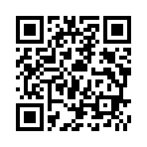
Earth Stories Film Festival
Ready to act, raise awareness about climate change and become an Earth Guardian?
Put your film making skills to the test and enter the Earth Stories Film Festival competition.
Submission deadline 16th January 2026
The following prizes will be awarded at the Earth Stories Film Festival:
Animation Award £250,
Experimental Award £250,
Documentary Award £250,
Fiction Award £250,
Young Film Award (Up to 16 Years old) £250,
Local Filmmaker Award (Staffordshire, Cheshire, Shropshire) £250.
More information, including terms and conditions, can be found here:
Earth Stories - Keele University

Slide 6





Become an Earth Guardian!
Complete one activity from each of the themes to become an Earth Guardian
Themes:
Collect each sticker to gain your
Earth Guardian certificate
Climate
Crisis
Nature's
degradation
Sustainable
Futures
Human-nature connection
  Earth Stories
  Film Festival

Slide 7
Earth Guardian Sticker Log
Sticker | Activity Completed

Slide 8

Teacher:
Name:
This certificate is awarded because an activity linked to all themes has been completed to become an Earth Guardian!
Earth Guardian
Certificate
Date:

Slide 9
Film 1: Saving Littlejohn

Slide 10
Lesson Plan
Activity time: 90 minutes
This activity is designed to get students thinking about how climate change is affecting species globally and what is being done to save them.
English National Curriculum Links | KS1 Science: Year 2 - identify that most living things live in habitats to which they are suited and describe how different habitats provide for the basic needs of different kinds of animals and plants, and how they depend on each other; identify and name a variety of plants and animals in their habitats, including microhabitats; notice that animals, including humans, have offspring which grow into adults. Whilst the current curriculum doesn’t explicitly mention climate related themes, teachers can integrate related content through cross-curricular approaches. | KS2 Science: Year 4 - recognise that environments can change and that this can sometimes pose dangers to living things. Year 5 - Describe the differences in the life cycles of a mammal, an amphibian, an insect and a bird. Year 6 - identify how animals and plants are adapted to suit their environment in different ways and that adaptation may lead to evolution. Whilst the current curriculum doesn’t explicitly mention climate related themes, teachers can integrate related content through cross-curricular approaches.
Key Vocabulary | KS1: Life cycle, territory, endangered, extinct, evaporate, conservation, captivity, species, disease. | KS2: Life cycle, metamorphosis, territory, vertebrate, invertebrate, endangered, extinct, evaporate, genetic diversity, conservation, captivity, species, disease.
Resources needed | Access to books/internet, Littlejohn’s fact file/Top Trumps card, Video questions & answers, Top Trumps Template, Paper and pens, Other climate related resources can be found on the FREE to use Explorify site. On the ‘science topic (all)’ drop down select ‘climate challenge’. | Careers Links: PSTT – A scientist just like me introduces children to a diverse range of scientists and people who work in science-related jobs. Related scientists: Animal Scientist – Hella Péter, Science Illustrator – Vicky Bowskill, Polar Scientist – Prem Singh Gill, Ecological Entomologist – Ben Woodcock.
Instructions:
Play ‘Metamorphosis Mayhem’ from BSW 2024 activity pack (page 23) to recap the life cycle of an amphibian (frog). (10 minutes).
Introduce ‘Littlejohn’ as an endangered species (use fact file/Top Trumps card). Discuss what could be affecting the tree frog’s life cycle that means it has become endangered.
Watch ‘Saving Littlejohn’ (10 minutes). Students could answer video questions to focus their viewing (answers provided).
Discuss the threats mentioned to the Littlejohn’s tree frog (fungal infection/disease, bush fires interbreeding/reduced genetic diversity). 10 minutes
Use the internet to find another species on the endangered list and investigate the reasons for this (45-60 minutes). Things to think about:
  What type of animal are they (Plant/Animal? Vertebrate/invertebrate? Mammal/Fish/Bird?)
  Where in the world are they found?
  What type of habitat do they live in?
  Which parts of its life cycle are being affected?
  What is the cause of this effect (pollution, deforestation, climate change, disease, wildfires, human activity)?
  Is anything been done to save them?
Create a ‘Top Trumps’ card for their chosen endangered species. Put all the cards together to create a class set (minimum of 20 per pack) which can be played time and time again.
Extra-curricular activity – encourage students to share their passion for all things climate related by creating an entry for the Earth Stories Film Festival! More information, including terms and conditions, can be found here: Earth Stories - Keele University

Slide 11
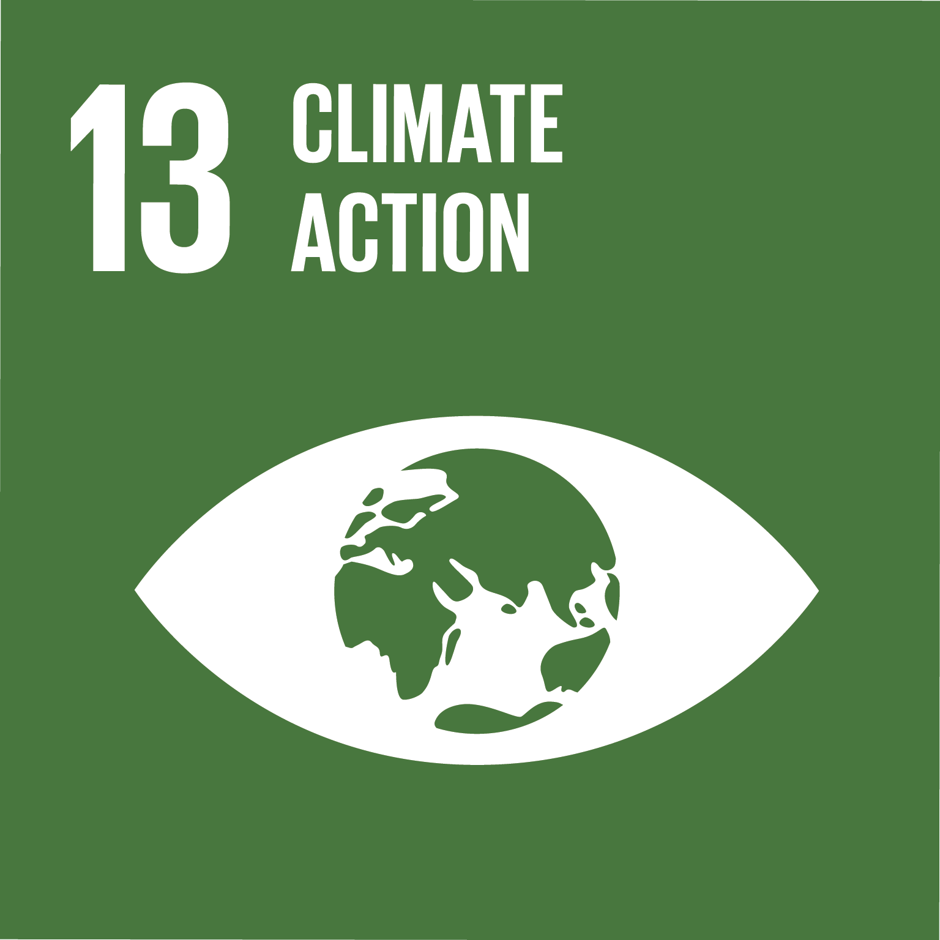
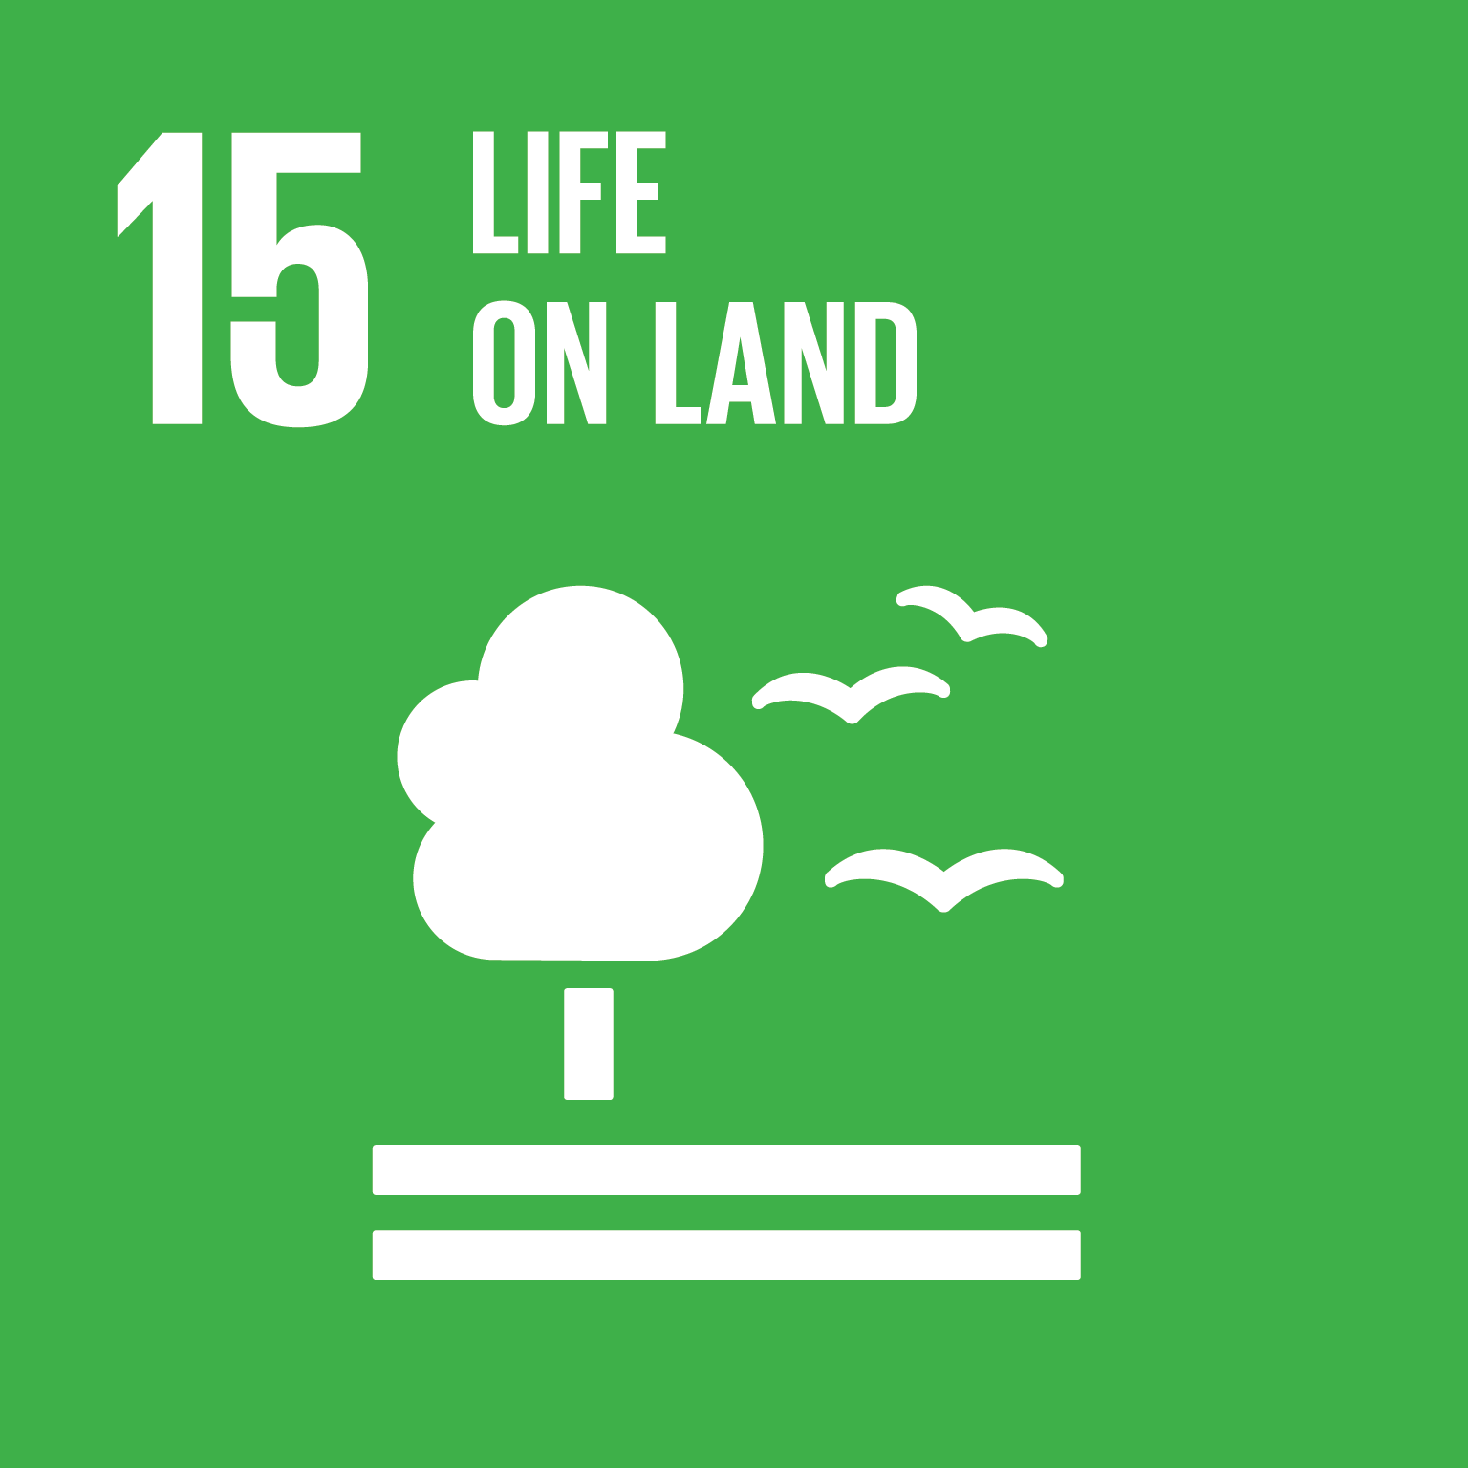

Education for Sustainable Development
Film: Saving Littlejohn
Theme: Endangered species, biodiversity, conservation, climate change
Main Activities:
  Understanding amphibian life cycles
  Investigating endangered species
  Exploring conservation efforts
Mapped to the United Nations Sustainable Development Goals:
 | Climate Action – Understanding how climate change affects species and ecosystems.
 | Life on Land – Focus on biodiversity, conservation of endangered species, and habitat protection.
 | Quality Education – Promotes scientific literacy and environmental awareness in young learners.
Mapped to UNESCO’s eight key competencies for sustainability, which are designed to equip learners with the knowledge, skills, values, and attitudes needed to contribute to sustainable development.
Systems Thinking | Students explore ecological systems (e.g., amphibian life cycles, ecosystems) and how climate change, disease, and human activity interact to affect biodiversity.
Critical Thinking | Learners investigate causes of endangerment and evaluate conservation strategies.
Collaboration | Group activities like creating Top Trumps cards foster teamwork and shared learning.
Integrated Problem-Solving | Students synthesize knowledge from science, geography, and environmental studies to propose conservation actions.

Slide 12
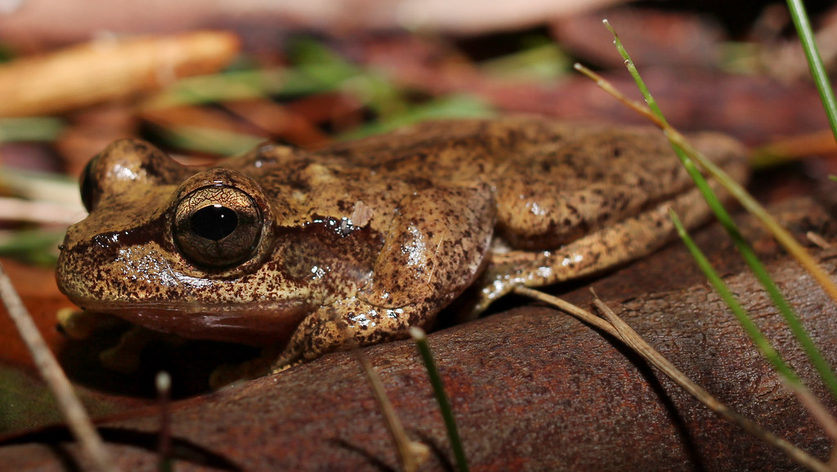
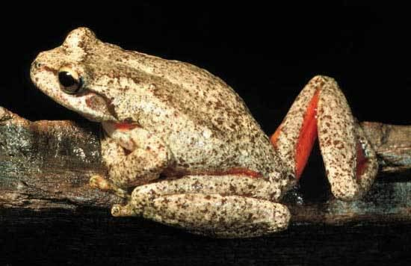
Name:
Littlejohn’s Tree Frog
Information:
Littlejohn’s Tree Frog is pale brown, with dark speckles and a broad, dark band down its back.
The belly is white or cream, and it has large orange patches on the groin, armpit and back of the thighs. It also has a brown bar from the tip of the snout through the nostrils to the top of the arm.
Status:
Endangered
50
Size:
5.0cm to 7.0cm
7
Habitat:
Forests; Plants & Leaves
31
Conservation
efforts:
Head starting, Captive breeding,
& Biobank
20
Notes:
Vulnerable = 25
Endangered = 50
critically endangered = 75
presumed extinct = 100

Slide 13
Name:
Information:
Status:
Size:
Habitat:
Conservation
efforts:
Notes:
Vulnerable = 25
Endangered = 50
critically endangered = 75
presumed extinct = 100

Slide 14
Littlejohn Video Questions
Where are Littlejohn tree frogs found?
Which part of the forest do they live in?
What do their large eyes give them?
What do the male frogs compete for?
At the pond, what is the biggest threat to the tree frogs?
How many amphibian species has the fungus affected?
Further south, in the Blue Mountains, what is another threat to Littlejohn Frog?
What caused the tadpoles to suffocate and die?
Why does a female go towards the loudest voice?
What is the problem with having a small population number?
What are citizen scientists doing to help the tree frogs?
What are scientists collecting at the ponds?
What is ‘head starting’? Why is it important?
Why have scientists started a captive breeding colony?
What is collected for a biobank?
Why is it important this is collected?

Slide 15
Littlejohn Video Q’s Answers
Where are Littlejohn tree frogs found? Australia/Australian Bush.
Which part of the forest do they live in? Below the grass, on the forest floor.
What do their large eyes give them? Excellent night vision, sensitive to the slightest movement.
What do the male frogs compete for? Territory.
At the pond, what is the biggest threat to the tree frogs? Disease – fungus (chytrid).
How many amphibian species has the fungus affected? Over 500 species worldwide, with 90 going extinct.
Further south, in the Blue Mountains, what is another threat to Littlejohn Frog? Bush fires.
What caused the tadpoles to suffocate and die? Evaporated ponds
Why does a female go towards the loudest voice? Likely to be the strongest/fittest male.
What is the problem with having a small population number? In-breeding leading to loss of genetic diversity and more abnormalities.
What are citizen scientists doing to help the tree frogs? Setting up acoustic data loggers to record calling males to locate remaining colonies.
What are scientists collecting at the ponds? Eggs and tadpoles.
What is ‘head starting’? Reducing environmental pressures raising eggs and tadpoles in captivity until they are juveniles, when they are released into the wild. Why is it important? Higher rate of survival which should increase population numbers in the wild.
Why have scientists started a captive breeding colony? Insurance colony and increase genetic diversity.
What is collected for a biobank? Littlejohn Tree Frog sperm cells.
Why is it important this is collected? Insurance policy to bring the species back and help the conservation of the species before it becomes extinct.

Slide 16
Film 2:
Send Kelp

Slide 17
Lesson Plan
Activity time: 90 minutes +
This activity is designed to get students thinking about the impact of plastic pollution and what can be done to tackle the issue.
English National Curriculum Links | KS1 Explicit links to maths (adding and subtracting, estimating), English (writing instruction), science (properties of materials) and design technology (design and make processes) can be made to this activity. Specific links will depend on the year group you aim this activity at. Whilst the current curriculum doesn’t explicitly mention climate related themes, teachers can integrate related content through cross-curricular approaches. | KS2 Explicit links to maths (adding and subtracting numbers up to 1000, reading numbers up to 10,000, estimating), English (writing instructions), science (properties of materials) and design technology (design, make and evaluate processes) can be made to this activity. Specific links will depend on the year group you aim this activity at. Whilst the current curriculum doesn’t explicitly mention climate related themes, teachers can integrate related content through cross-curricular approaches.
Key Vocabulary | KS1: estimate, plastic, pollution, properties, reduce, reuse, recycle. | KS2: organisms, estimate, plastic, pollution, properties, reduce, reuse, recycle, renewable, compare, evaluate.
Resources needed | Access to books/internet, Before you run the activity collect snack wrappers from your class/other classes during a break time, Student activity sheet, FOR PROTOTYPING: Playdough or modelling clay, scrap paper, variety of beeswax wraps. FOR MAKING: Organic cotton, pinking shears or sharp scissors, sustainably sourced food-grade beeswax pellets (or block and a grater) approx. 14g per 20cm by 20cm wrap, baking paper, ironing board and iron (under adult supervision). | Careers Links: Environmental campaigners put pressure on organisations and the government to make the best decisions for the environment. Environmental consultants advise their clients on environmental issues to reduce environmental damage. A scientist just like me: Coastal Researcher – Dr Juliette Jackson, Renewable Materials Engineer – Dr Raquel Prado, Science Illustrator – Vicky Bowskill.
Instructions:
Watch ‘Send Kelp’ (5 minutes).
Discuss with students what the story was about (British coastal organisms – Grey seal, Kelp, sharks, sea grass plains. Plastic pollution (plastic bottle (had ‘scout springs’ on it. They called the seal scout in their imagination) and collected in the bucket). Watch the film again to aid discussions (15 minutes).
Ask why they think the film/story is called ‘Send Kelp’ (play on words – send help; kelp are underwater trees, absorbing carbon dioxide). Why do they need help? Focus the discussion on plastic pollution. Should these things be there? Why? 5 minutes.
As a class, count how many snack wrappers were collected from one breaktime. You could collect wrappers from several classes and create a tally chart/graph of the results. Ask them to estimate how many wrappers are thrown away every week/month/term/year (adapt this activity so that it is suitable for the level of your class). 25 minutes.
How would this number compare to other schools (small schools with less than 100 students, compared to bigger schools with 500+ pupils)? As a class estimate how many wrappers would be thrown away from all 20,806 primary schools. You could refer to The Big Plastic count 2024 results and teaching resources here (10 minutes).
Discuss what could be done to solve this problem (reduce, reuse, recycle; alternative packaging materials)? 5 minutes.
Use Pack it in – Explorify activity to design a new wrapper that will keep a snack fresh without using plastic (adapt this activity so that it is suitable for the level of your class). 30 minutes+.
Extra-curricular activity – encourage students to share their passion for all things climate related by creating an entry for the Earth Stories Film Festival! More information, including terms and conditions, can be found here: Earth Stories - Keele University

Slide 18
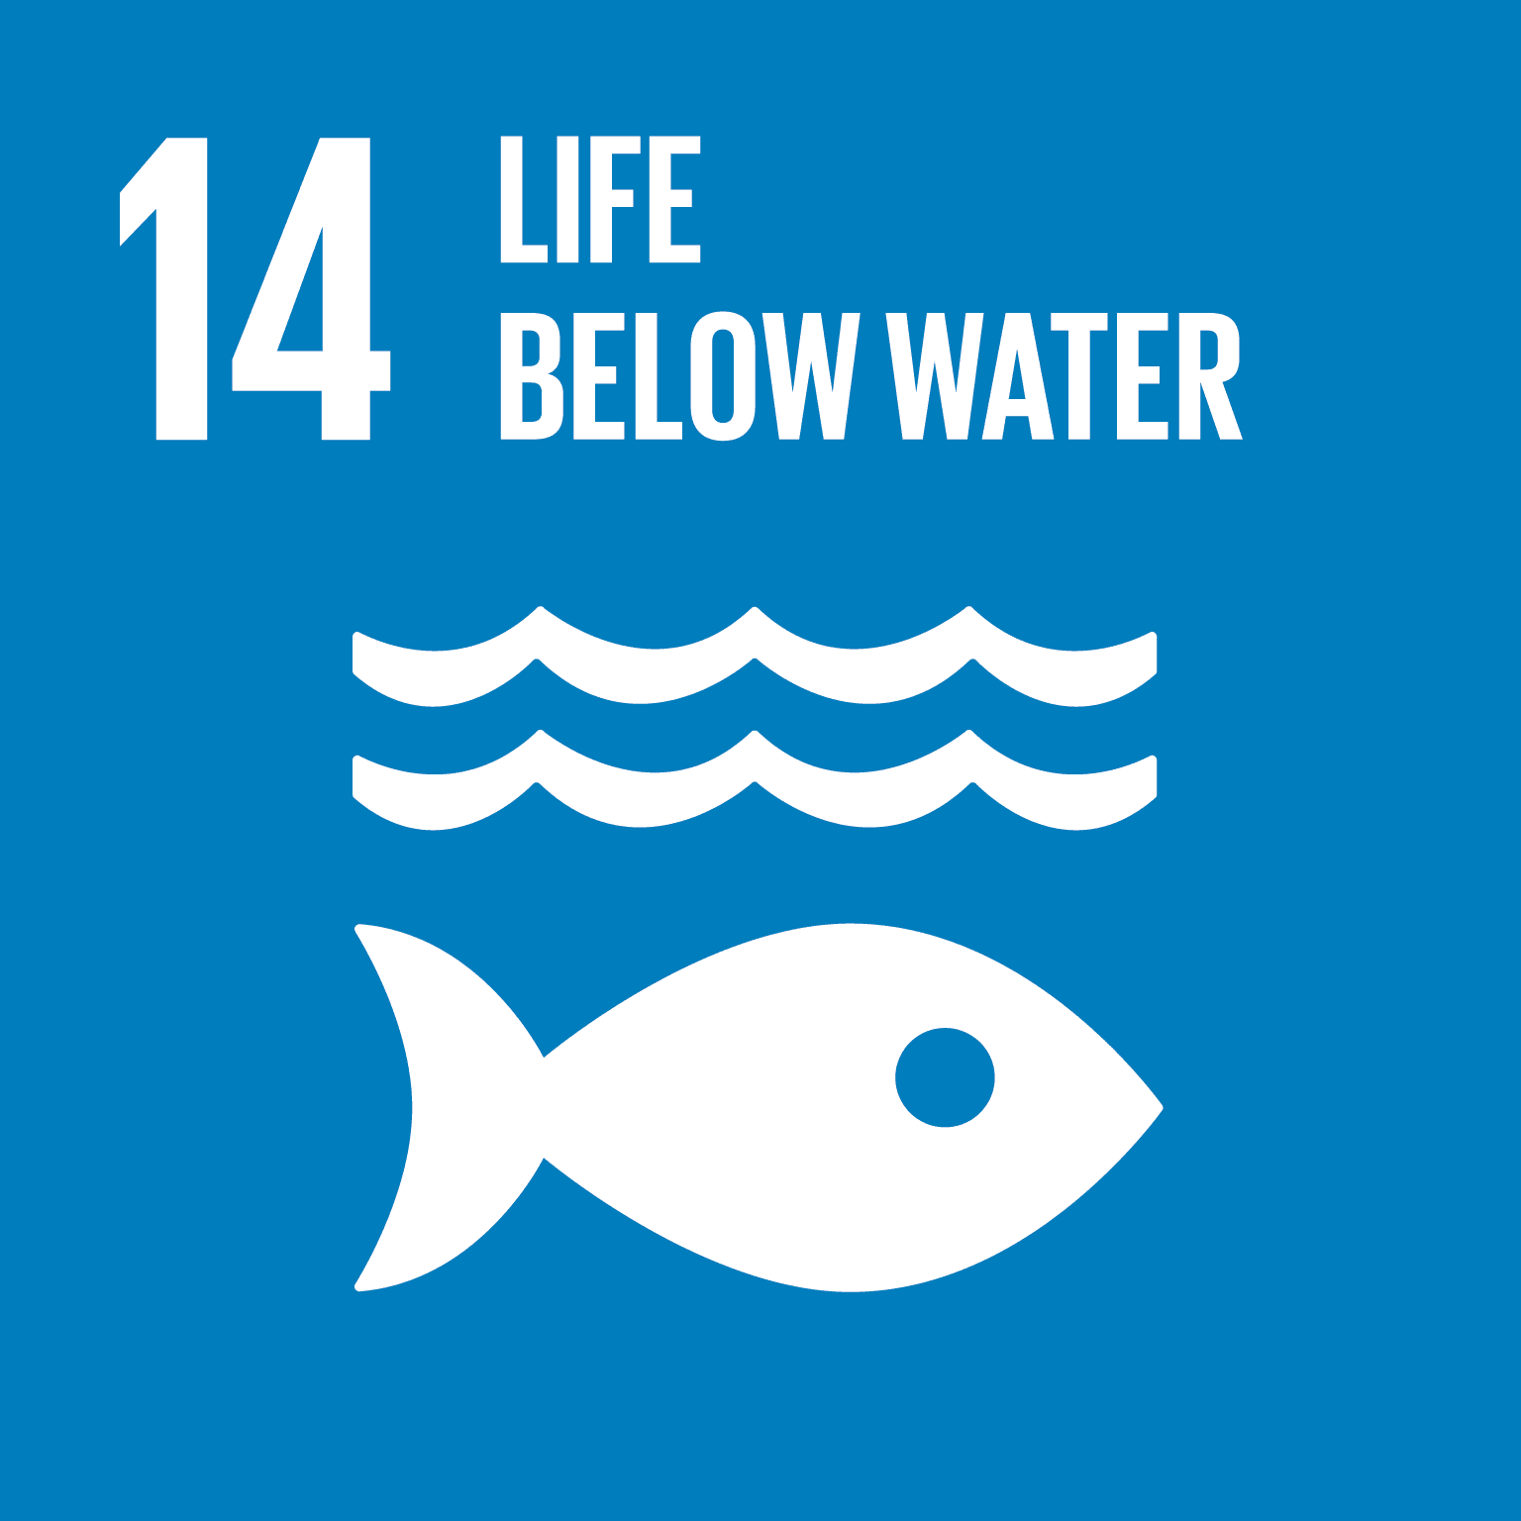

Education for Sustainable Development
Film: Send Kelp
Themes: Marine ecosystems, plastic pollution, sustainable materials
Main Activities:
  Exploring marine life and pollution
  Estimating plastic waste
  Designing eco-friendly packaging
Mapped to the United Nations Sustainable Development Goals:
 | Life Below Water – Addresses marine pollution and the importance of healthy ocean ecosystems.
 | Responsible Consumption and Production – Encourages reducing plastic use and designing sustainable alternatives.
 | Climate Action – Highlights the role of kelp in carbon absorption and the broader impact of pollution on climate.
 | Quality Education – Engages students in problem-solving and environmental stewardship.
Mapped to UNESCO’s eight key competencies for sustainability, which are designed to equip learners with the knowledge, skills, values, and attitudes needed to contribute to sustainable development.
Anticipatory | Students estimate future plastic waste and consider long-term environmental impacts.
Normative | Learners reflect on values related to consumption and sustainability, and design alternatives to plastic packaging.
Strategic | Through designing new wrappers, students develop and test strategies for reducing plastic use.
Collaboration | Activities involve class-wide data collection and group design tasks.

Slide 19
Send Kelp Activity Sheet
Did you know there are ~20,806 primary schools in the UK?
Our class snack wrapper count for one breaktime = ________
Over a week (5 school days) we estimate there would be ________ wrappers!
In one school year (39 weeks) we estimate there would be _______ wrappers just for our class!
Your challenge:
Design a new wrapper that will keep a snack fresh without using plastic.
My Design Ideas:
My Prototype (glue a photograph here):
Things I could do to improve my design:
We should design and use snack wrappers that do not contain plastic materials because…….
Our final wrapper design (draw/photo):

Slide 20
Film 3:
Before

Slide 21
Lesson Plan
Activity time: 60 minutes (allow additional time for follow-up activities)
This activity is designed to get students thinking about the social, economic and environmental impacts of human activity (tourism).
English National Curriculum Links | KS1 Geography Understand geographical similarities and differences through studying the human and physical geography of a small area of the United Kingdom, and of a small area in a contrasting non-European country. Use basic geographical vocabulary to refer to: key physical features, including beach, cliff, coast, forest, hill, mountain, sea, ocean, river, soil, valley, vegetation, season and weather, key human features, including city, town, village, factory, farm, house, office, port, harbour and shop. Whilst the current curriculum doesn’t explicitly mention climate related themes, teachers can integrate related content through cross-curricular approaches. | KS2 Geography Describe and understand key aspects of human geography, including types of settlement and land use, economic activity including trade links, and the distribution of natural resources including energy, food, minerals and water. Whilst the current curriculum doesn’t explicitly mention climate related themes, teachers can integrate related content through cross-curricular approaches.
Key Vocabulary | KS1: positive, negative, impact, tourism, pollution. | KS2: social, economic, environmental, tourism, pollution, indigenous, deforestation, impact, positive, negative, culture.
Resources needed | Access to books/internet, Impacts of tourism card sort (you may need to define some of these words before carrying out the activity) & answers, Role play discussion point cards. | Careers Links: Environmental consultants advise their clients on environmental issues to reduce environmental damage. Ecotourism Guide: These guides educate tourists about local ecosystems, wildlife, and conservation efforts. They play a crucial role in promoting sustainable travel and minimising negative impacts.
Instructions:
Watch ‘Before’ (7 minutes). Note: This film contains English subtitles – you may need to read these aloud to students.
Discuss with students what the story was about (Deforestation/habitat destruction, tourism, plastic/waste pollution, impacts on indigenous people, effects of internet/social media). Watch the film again to aid discussions (10 minutes).
In small groups students sort the positive and negative impacts of tourism cards – make sure you define culture before students carry out this activity (10 minutes). As an extension students could then sort each into the following categories: a) Social Impacts; b) Economic Impacts, and; c) Environmental effects.
Role Play - divide students into 4 groups, assigning each group a role (tourist, local resident, business owner, environmentalist). Each group discusses the impact of tourism from their perspective (use discussion points and card sort to scaffold activity). 15 minutes.
Take one student from each role to form new groups. Give them time to discuss the impacts from their perspectives. Encourage debate, whilst respecting other's opinions (20 minutes)
Follow-up suggestions (allow additional time for these):
  Students create an informative poster highlighting the positive and negative impacts of tourism on coastal towns.
  Students write short stories/poems including the impacts discussed during the role play.
  Write a persuasive letter to your local MP, either for or against the development of a new tourist attraction in your town. You could send these off and ask for a response.
Extra-curricular activity – encourage students to share their passion for all things climate related by creating an entry for the Earth Stories Film Festival! More information, including terms and conditions, can be found here: Earth Stories - Keele University

Slide 22


Education for Sustainable Development
Film: Before
Theme: Tourism, deforestation, indigenous communities, environmental and social impacts
Main Activities:
  Analysing tourism impacts
  Role-playing different perspectives
  Creating persuasive writing and posters
Mapped to the United Nations Sustainable Development Goals:
 | Sustainable Cities and Communities – Encourages sustainable tourism and community resilience.
 | Climate Action – Discusses the environmental consequences of urbanisation and tourism.
 | Life on Land – Focuses on deforestation and habitat loss.
 | Reduced Inequalities – Highlights the impact of tourism on indigenous communities.
 | Quality Education – Promotes critical thinking and civic engagement.
Mapped to UNESCO’s eight key competencies for sustainability, which are designed to equip learners with the knowledge, skills, values, and attitudes needed to contribute to sustainable development.
Systems Thinking | Students examine the interconnected social, economic, and environmental impacts of tourism.
Critical Thinking | Role-play and card sorting activities encourage analysis of multiple perspectives and consequences.
Self-Awareness | Learners reflect on their own values and the impact of tourism on communities and ecosystems.
Collaboration | Group discussions and debates foster empathy, negotiation, and collective decision-making.

Slide 23
Card Sort
Card Sort (print onto card & cut up)
Tourism creates jobs, supporting local businesses. | It makes money through accommodation, restaurants, and attractions.
Tourists spend money on souvenirs and services. | Tourism promotes cultural understanding and appreciation.
Visitors learn about local traditions, food, and customs. | Cultural exchange enriches both tourists and residents.
Tourism drives improvements to roads, airports, utilities (water, gas, electricity). | Better facilities benefit locals beyond the tourism sector.
Overcrowding harms natural sites (e.g., erosion, pollution). | Habitat destruction affects wildlife and ecosystems.
Resource use strains water and energy supplies. | Tourist demand can lead to a loss of meaning of cultural traditions (e.g., symbols, dances, foods).
Cultural traditions may be changed to appeal to tourists. | Noise and congestion impact quality of life.
Increased tourism can strain local services (healthcare, transportation). | Residents may face higher living costs due to tourism.

Slide 24
Card Sort - Answers
Positive Effects:
Tourism creates jobs, supporting local businesses. | It makes money through accommodation, restaurants, and attractions.
Tourists spend money on souvenirs and services. | Tourism promotes cultural understanding and appreciation.
Visitors learn about local traditions, food, and customs. | Cultural exchange enriches both tourists and residents.
Tourism drives improvements to roads, airports, utilities (water, gas, electricity). | Better facilities benefit locals beyond the tourism sector.
Economic Impact
Economic Impact
Economic Impact
Social Impact
Social Impact
Social Impact
Economic/Environmental /Social Impact
Economic/Social Impact
Negative Effects:
Overcrowding harms natural sites (e.g., erosion, pollution). | Habitat destruction affects wildlife and ecosystems.
Resource use strains water and energy supplies. | Tourist demand can lead to a loss of meaning of cultural traditions (e.g., symbols, dances, foods).
Cultural traditions may be changed to appeal to tourists. | Noise and congestion impact quality of life.
Increased tourism can strain local services (healthcare, transportation). | Residents may face higher living costs due to tourism.
Environmental Impact
Environmental Impact
Environmental Impact
Social Impact
Social Impact
Economic/Environmental /Social Impact
Economic/Environmental /Social Impact
Economic/Social Impact

Slide 25
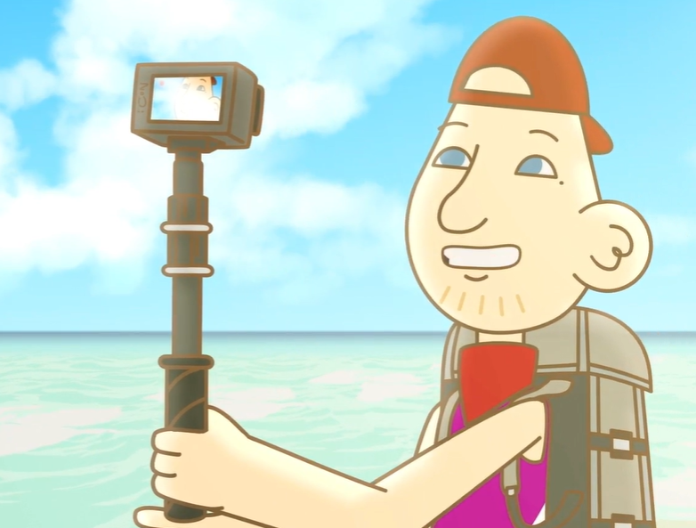
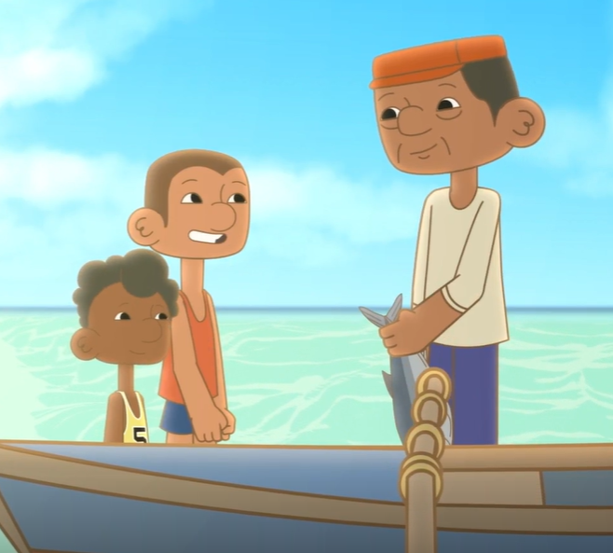
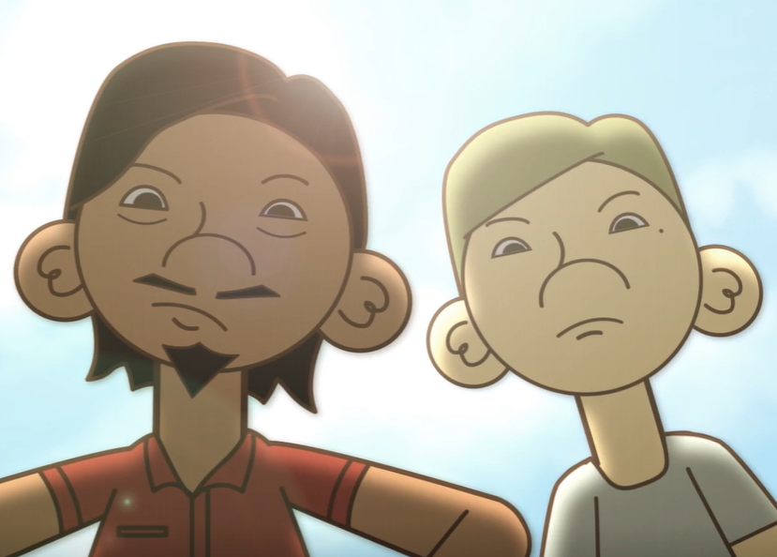
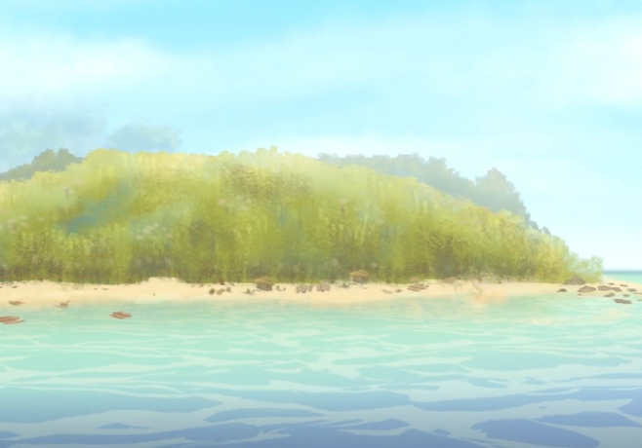
Role Play Discussion Points
Tourist – things to talk about: Positive: Tourists spend money on accommodation, food, and attractions, benefiting local businesses. Tourists can learn about local traditions, language, and customs. Sharing positive experiences can attract more visitors. Negative: Discuss litter, pollution, and damage to ecosystems caused by tourism. Can sometimes push out local residents or change their way of life. Large numbers of tourists can strain roads, services and natural sites.
Local Residents – things to talk about: Positive: Tourism-related jobs benefit local residents. Showcasing local culture can boost community spirit. Money from tourism can improve roads, utilities, and public spaces. Negative: Consider how increased tourism can affect daily life. House prices rising might mean local residents cannot afford them. Catering to what tourists want might change the local character.
Business owner – things to talk about: Positive: Tourism can boost sales and profits. Catering to tourists can encourage new business ventures. Connections with other businesses and suppliers can be created. Negative: Tourism can lead to busy (6 weeks holidays) and slow periods (winter). Businesses compete with each other for tourist attention. How can you keep local character of the town while meeting tourist demands.
Environmentalist – things to talk about: Positive: Tourism money can fund environmental protection or conservation areas. Tourists can learn about local ecosystems, habitats and wildlife. Local residents and tourists can become ambassadors for environmental causes. Negative: Consider the impact of foot traffic, waste, and pollution. Tourism can affect wildlife habitats (hotels, roads etc being built). The carbon footprint of travel and its impact on the environment.

Slide 26
Film 4:
Robbie & Mollie

Slide 27
Lesson Plan
Activity time: 60 minutes (allow additional time for follow-up activities)
This activity is designed to get students thinking about the social, economic and environmental impacts of human activity (tourism).
English National Curriculum Links | KS1 English through storytelling and discussion, geography via exploring human and natural environments, science by introducing habitats and environmental change, computing through digital content creation, and art via visual storytelling and design. Specific links will depend on the year group you aim this activity at. Whilst the current curriculum doesn’t explicitly mention climate related themes, teachers can integrate related content through cross-curricular approaches. | KS2 English through narrative planning and discussion, geography via environmental impact, science through ecosystems and adaptation, computing with digital storytelling, and art through visual design and animation. Specific links will depend on the year group you aim this activity at. Whilst the current curriculum doesn’t explicitly mention climate related themes, teachers can integrate related content through cross-curricular approaches.
Key Vocabulary | KS1: Pollution; Recycle; Nature; Plastic; Habitat; Litter; Clean; Sort | KS2: Climate crisis; Sustainability; Degradation; Ecosystem; Microplastics; Storyboard; Animation; Conservation
Resources needed | Access to books/internet, Images of polluted vs. clean environments Storyboard Template Computers/Tablets capable of stop-motion animation | Careers Links: Animator / Stop-Motion Artist – Uses storytelling and visual design to create animations, often for education or environmental campaigns. Marine Biologist – Works to understand and protect ocean life, including the impact of plastic pollution. Environmental Engineer – Designs solutions to reduce pollution and improve sustainability. Environmental Educator – Teaches others about nature and sustainability.
Instructions:
Give the images of polluted vs. clean environments to students to sort however they like. Discuss their ideas and then move the discussion on to how the images make them feel. Encourage them to imagine what the Earth might say if it could speak. Record and display their thoughts/ideas.
Watch ‘Robbie & Mollie’ (1 minute 15 seconds).
Discuss with students what the story was about (plastic pollution and its effect on marine life). Ask students how they think the film was made (stop-motion animation). Watch the film again to aid discussions (10 minutes).
In groups, pupils brainstorm their own story ideas, focussing on the theme of climate crisis, natures degradation, sustainable futures or human-nature connection, using the storyboard template. Return to your earlier discussions for inspiration or show some of the other films included in this pack.
Follow-up suggestion (allow additional time for this or incorporate into your existing computing lessons):
  Students create their storyboards using stop-motion animation. These could then be shared with the wider community through websites and/or social media platforms to promote events such as Earth Day. A competition element could also be introduced into this activity if appropriate.
Extra-curricular activity – encourage students to share their passion for all things climate related by creating an entry for the Earth Stories Film Festival! More information, including terms and conditions, can be found here: Earth Stories - Keele University

Slide 28
Education for Sustainable Development
Film: Robbie & Mollie
Key Themes: Plastic pollution, marine life, climate crisis, nature’s degradation, sustainable futures, human-nature connection.
Main Activities:
Image sorting and reflection/discussion on polluted vs. clean environments
Watch and discuss Robbie & Mollie (stop-motion short)
Brainstorm and storyboard original climate-themed animations
Optional: Create stop-motion animations and share with the community.
Mapped to the United Nations Sustainable Development Goals:
 | Climate Action - Encourages awareness and creative expression around climate change and its impacts.
 | Life Below Water - Focuses on marine pollution and its effects on ocean life, as seen in Robbie & Mollie.
 | Life on Land – Supports understanding of nature’s degradation and the importance of biodiversity.
 | Responsible Consumption and Production - Promotes reflection on plastic use and sustainable alternatives.
 | Quality Education – Promotes critical thinking and civic engagement.
Mapped to UNESCO’s eight key competencies for sustainability, which are designed to equip learners with the knowledge, skills, values, and attitudes needed to contribute to sustainable development.
Systems Thinking | Students explore how human actions (e.g. plastic use) affect ecosystems and communities.
Critical Thinking | Encourages analysis of environmental issues and creative problem-solving through storytelling.
Self-Awareness | Learners reflect on their feelings about environmental change and their role in shaping the future.
Collaboration | Group discussions and storyboarding foster teamwork and shared responsibility.
Normative | Promotes ethical thinking about sustainability, justice, and care for the planet.

Slide 29
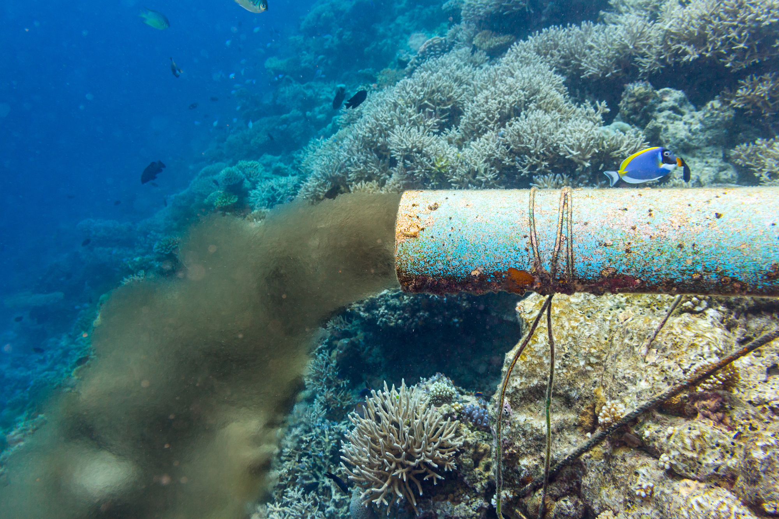
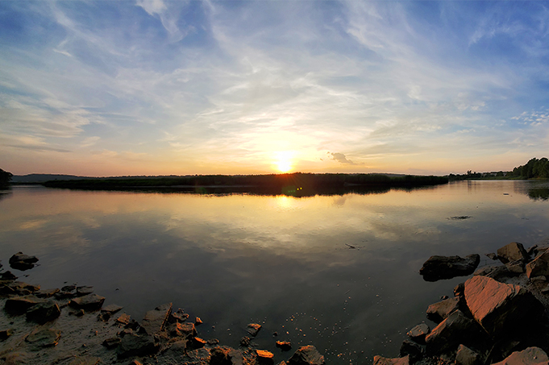
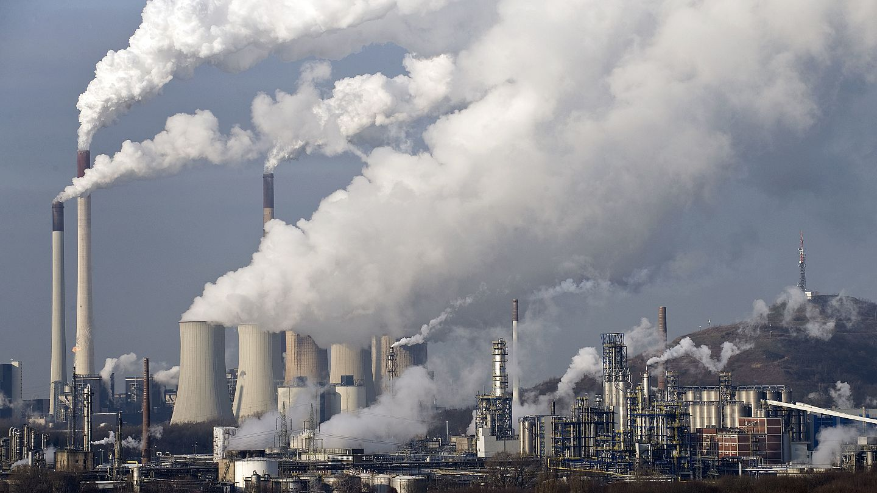
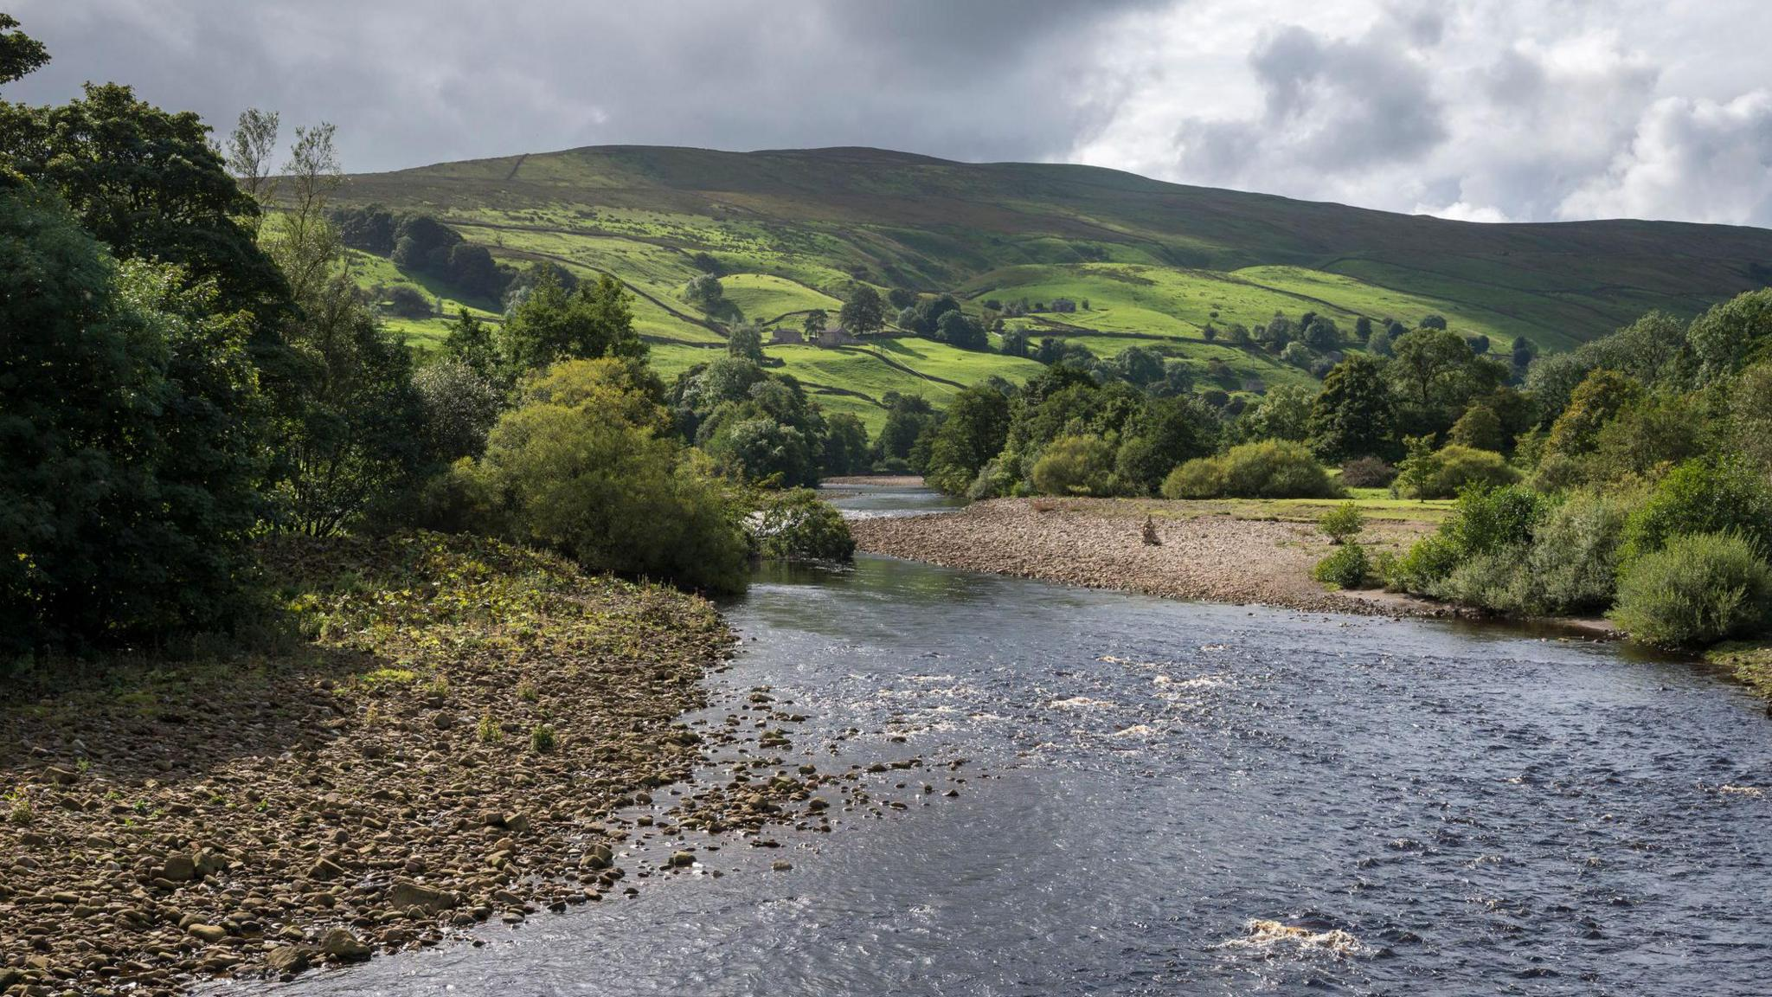
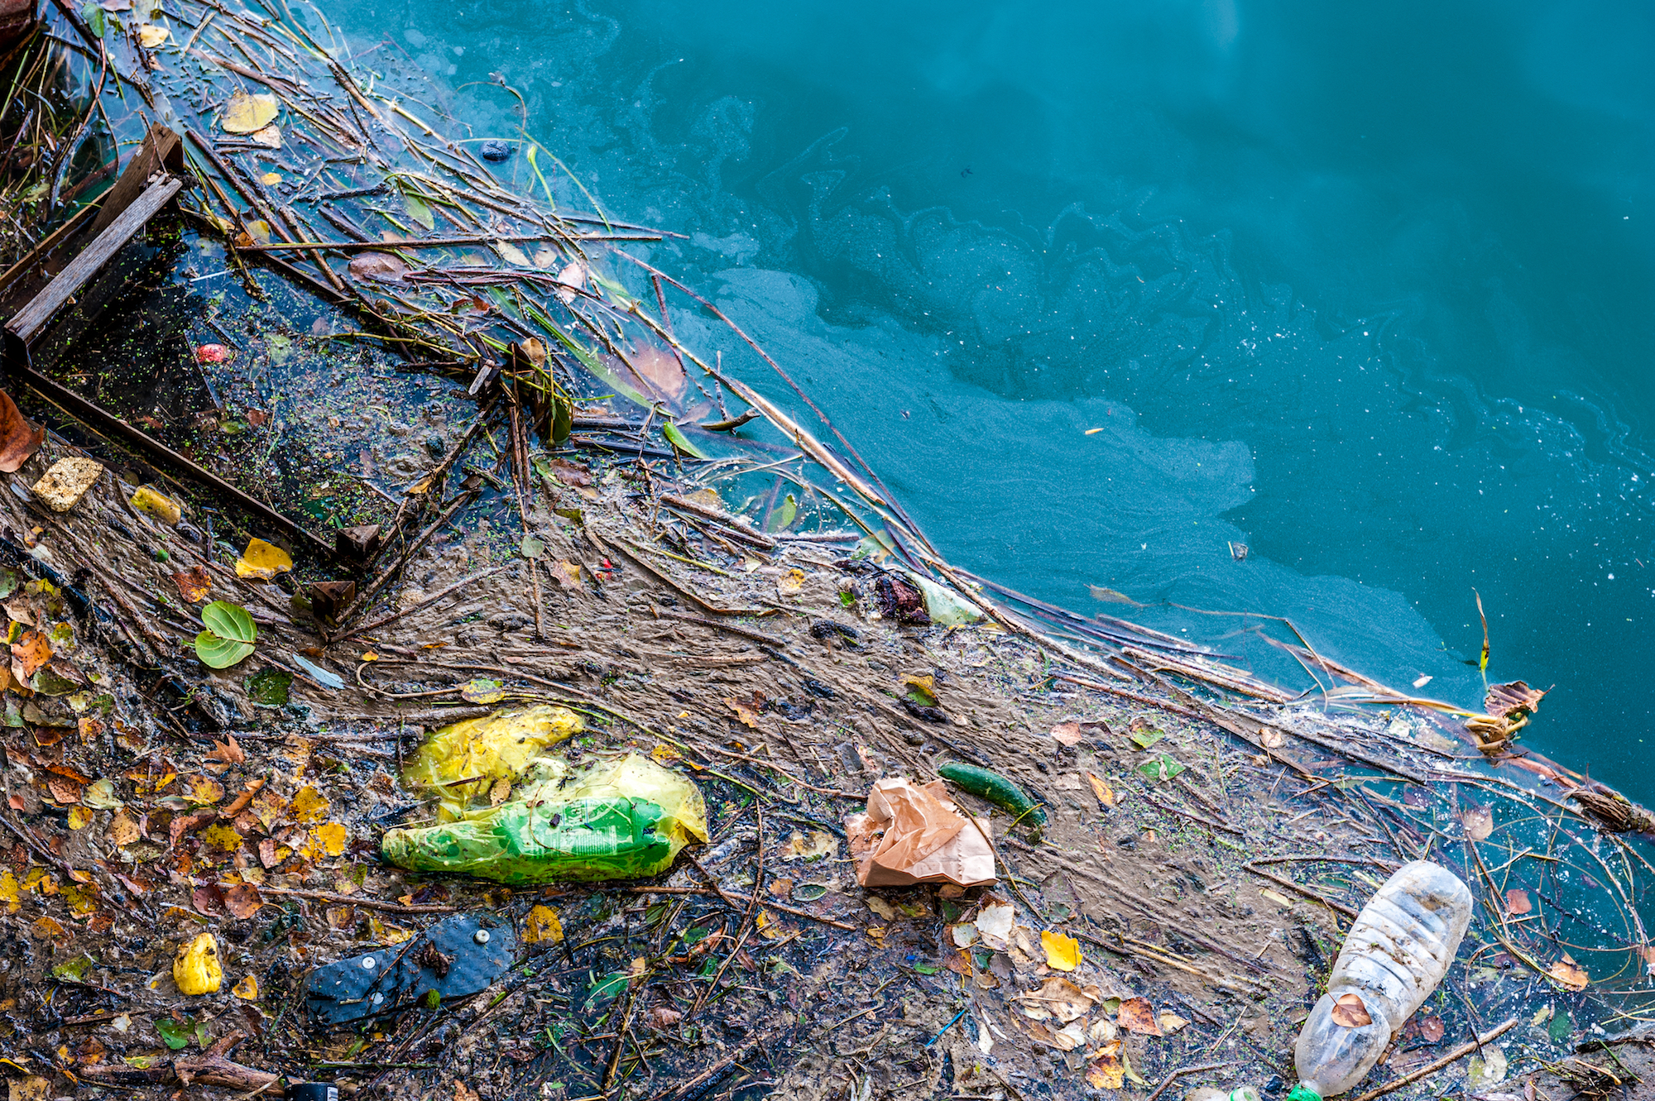
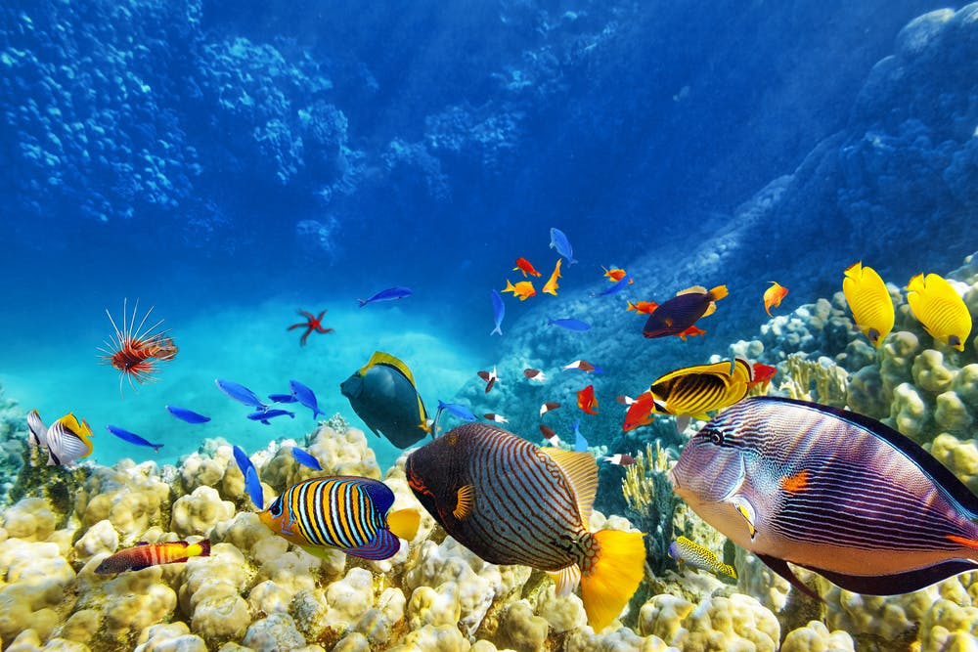
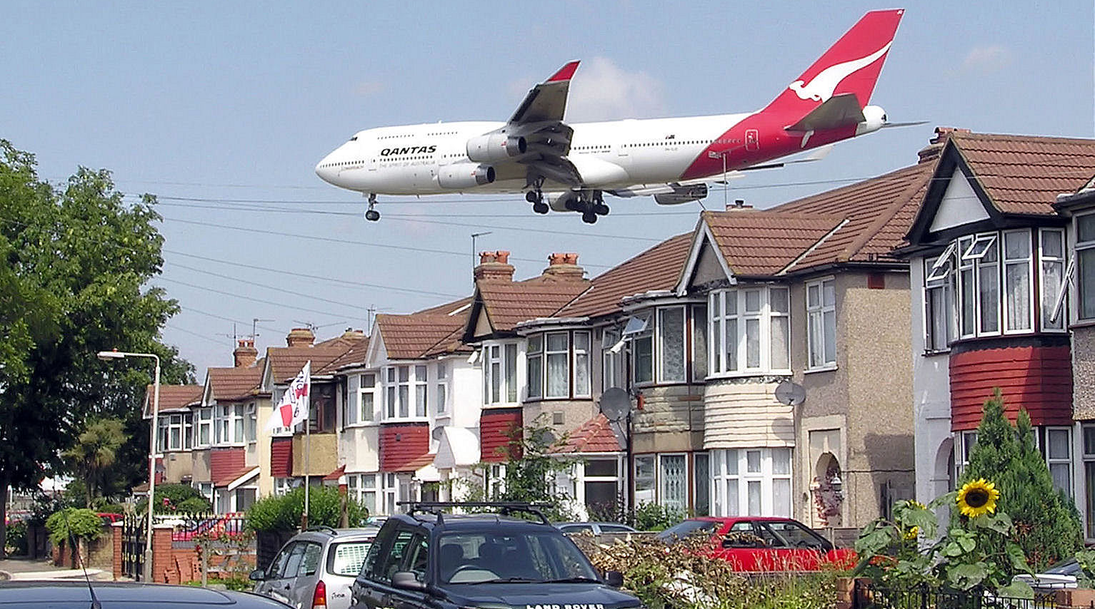
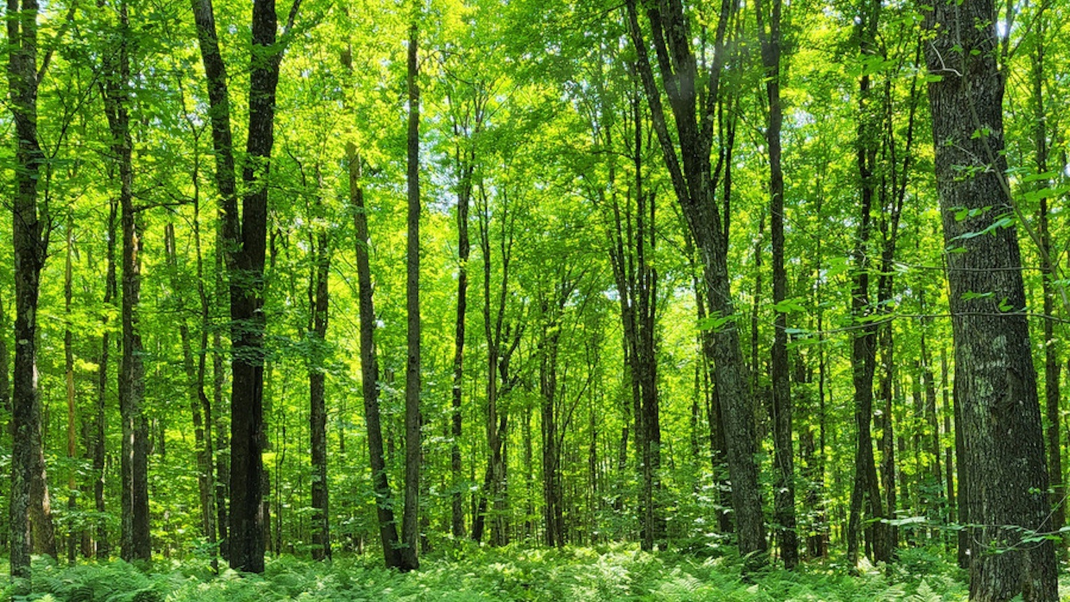
Polluted vs. clean environments
Cut these out for students to sort however they wish.
Creator: stockphoto-graf | Credit: Shutterstock / stockphoto-graf
Credit: R. Christopher O’Brien, Ph.D.
Copyright Martin Meissner/AP Photo
Credit: BBC News. GETTY Images
Creator: nomadFra | Credit: Shutterstock / nomadFra
Credit: Brian Kenney / shutterstock
Credit: Adrian Pingstone. Public Domain
Creator: Tony Dynek | Credit: Tony Dynek/USDA Forest Service

Slide 30
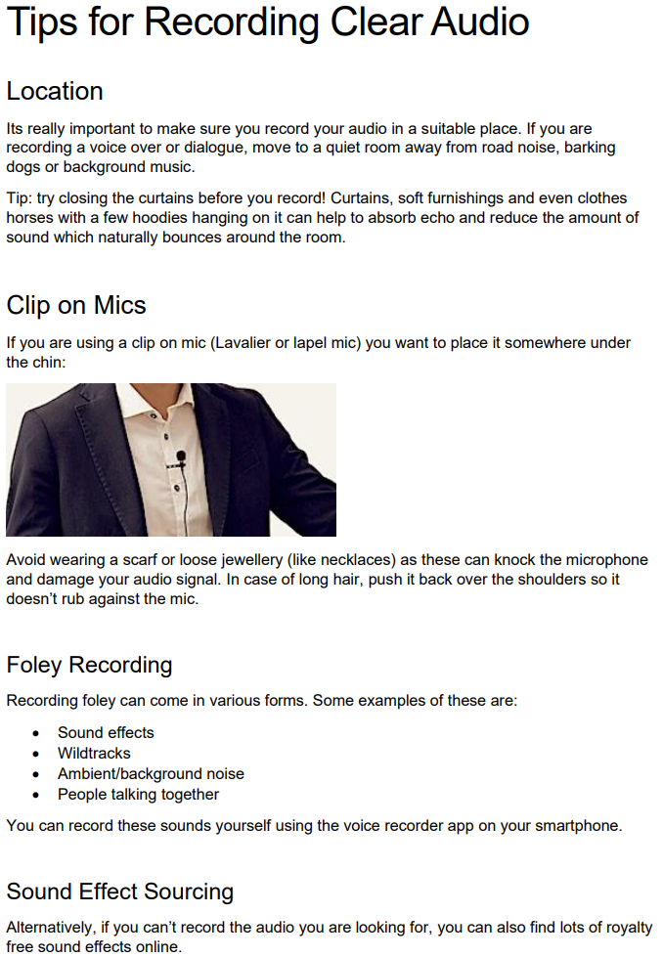
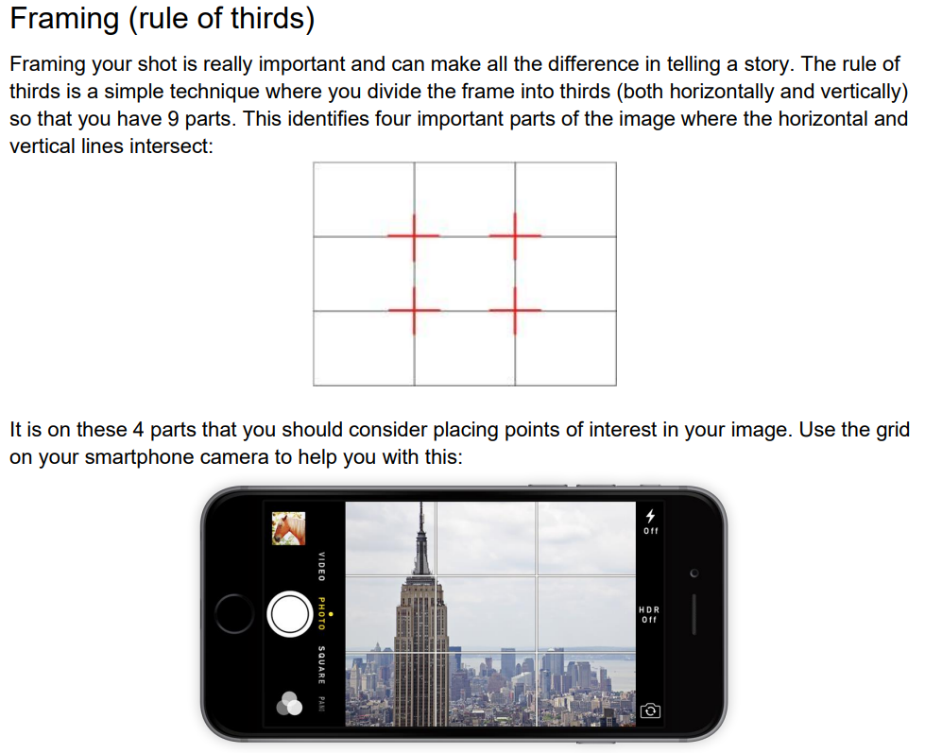
How to make a short film
          Tips and Tricks
The BBC have some great advice on how to film:
How to Film: Basic - BBC Bitesize
How to Film: Advanced - BBC Bitesize
How to edit: Basic - BBC Bitesize
How to Edit: Advanced - BBC Bitesize
There is also a parent/carers guide to help support children: How to help your child make a film at home - Parents Toolkit - BBC Bitesize
Sam Galantini - 2023
Some other helpful links:
More Great tips on shooting on your phone: https://teltblog.uclan.ac.uk/2020/01/27/five-tips-for-filming-with-a-mobile-phone/
Shoot Professional Videos with an Android Smartphone https://youtu.be/8YiwBsTQ_c0
Advanced smartphone shooting tips: https://www.pocket-lint.com/phones/news/131351-10-tips-for-recording-better-video-with-your-smartphone

Slide 31
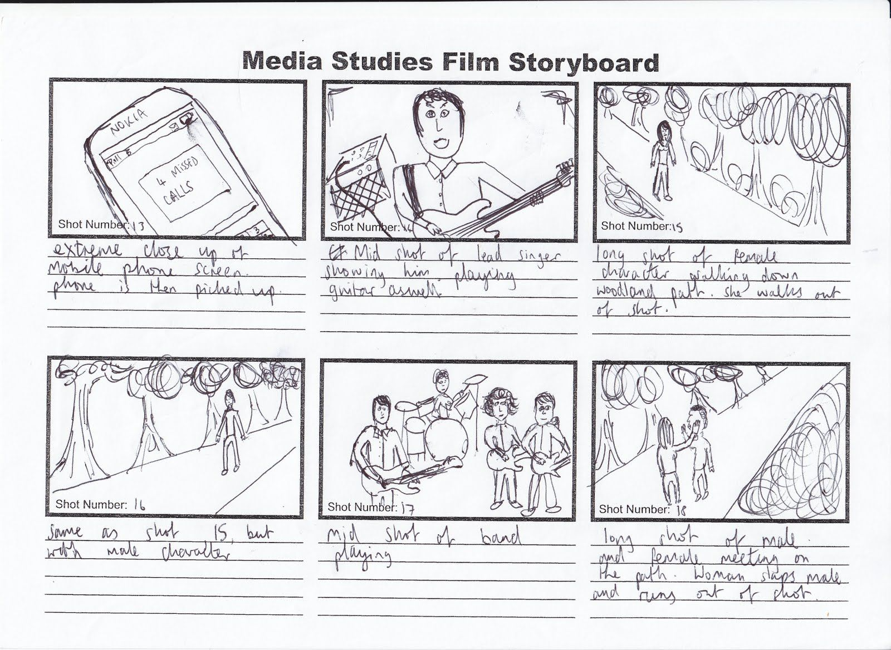
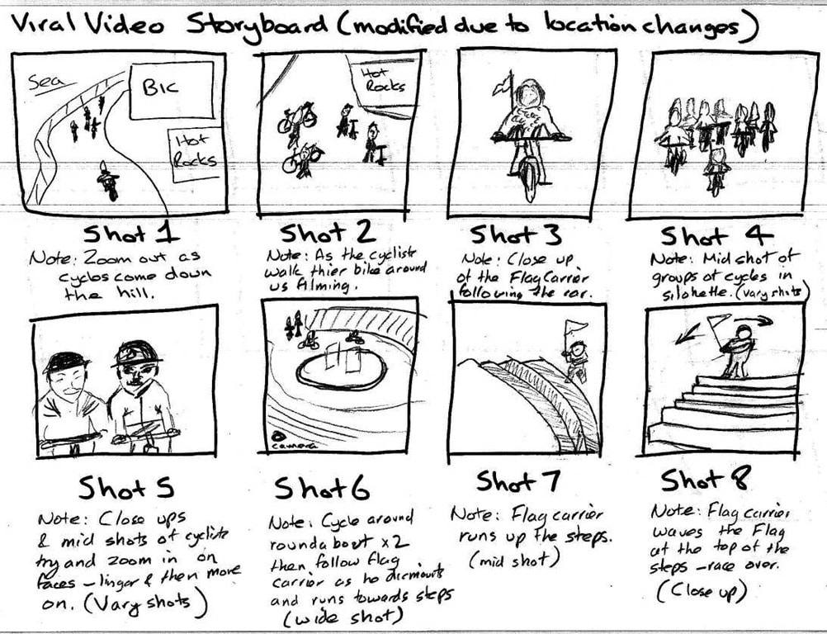
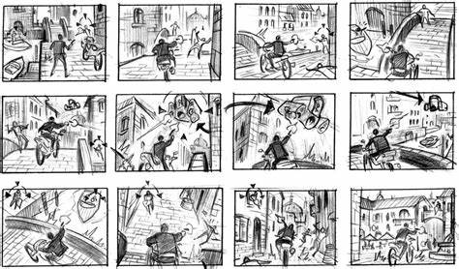
Storyboard Examples
Credit to:
krismediank.blogspot
Credit to:
trainingforgold.eu
Zhang Eliot (Pintrest)

Slide 32
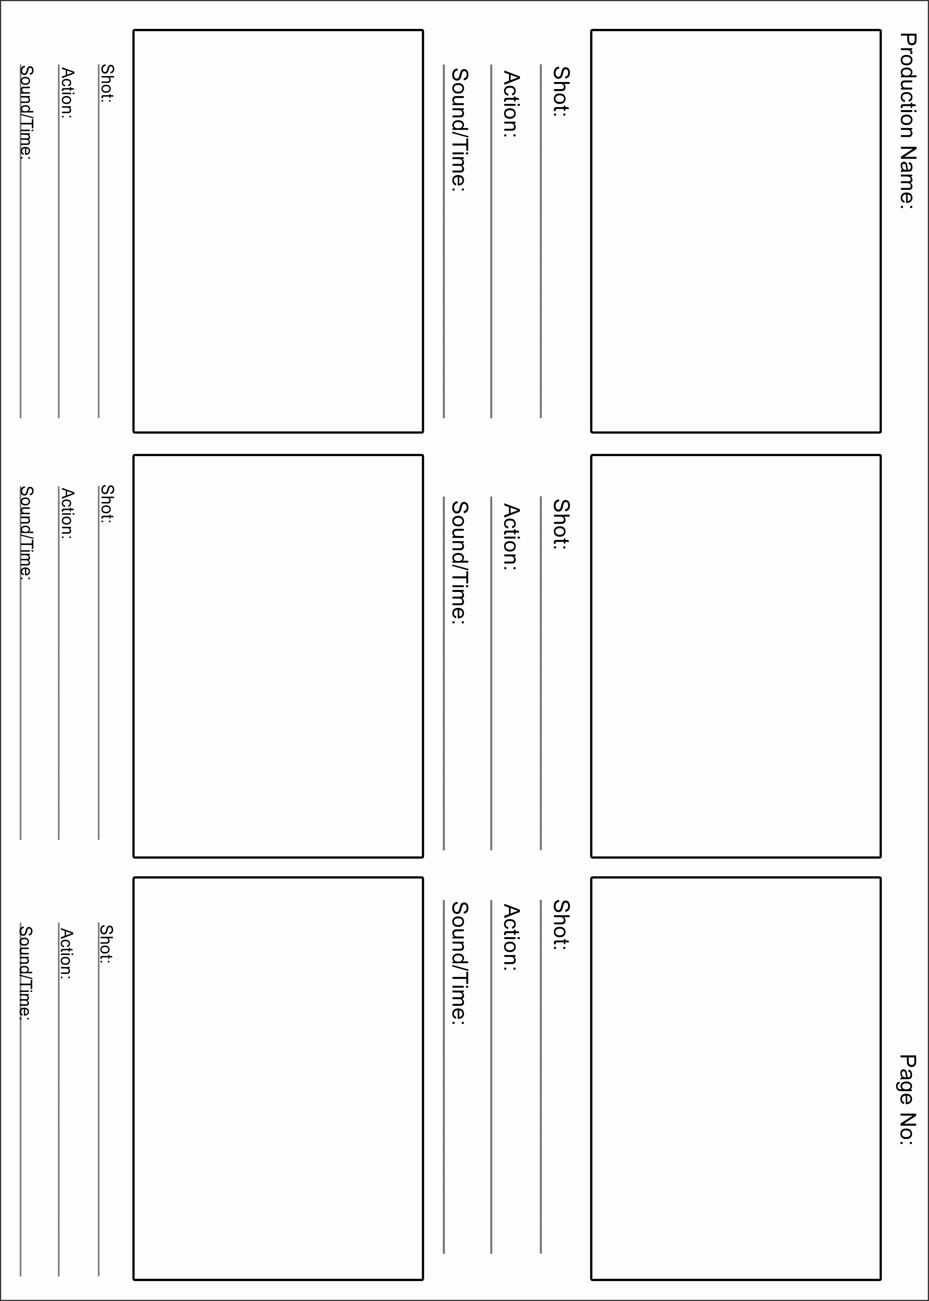
Storyboard Template
Template from: https://leonwebster.z19.web.core.windows.net/story-board-template-pdf.html

Slide 33

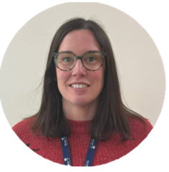
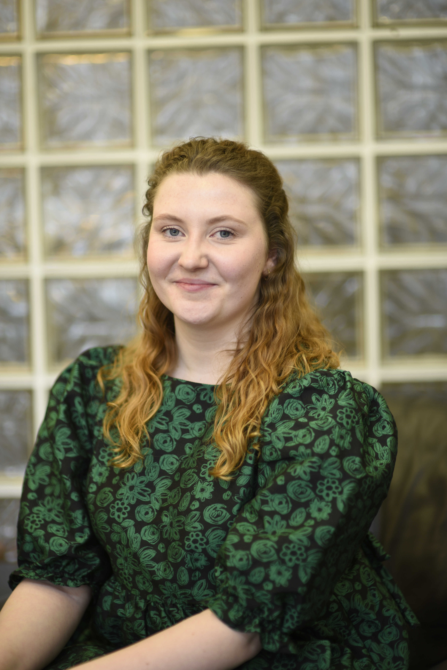
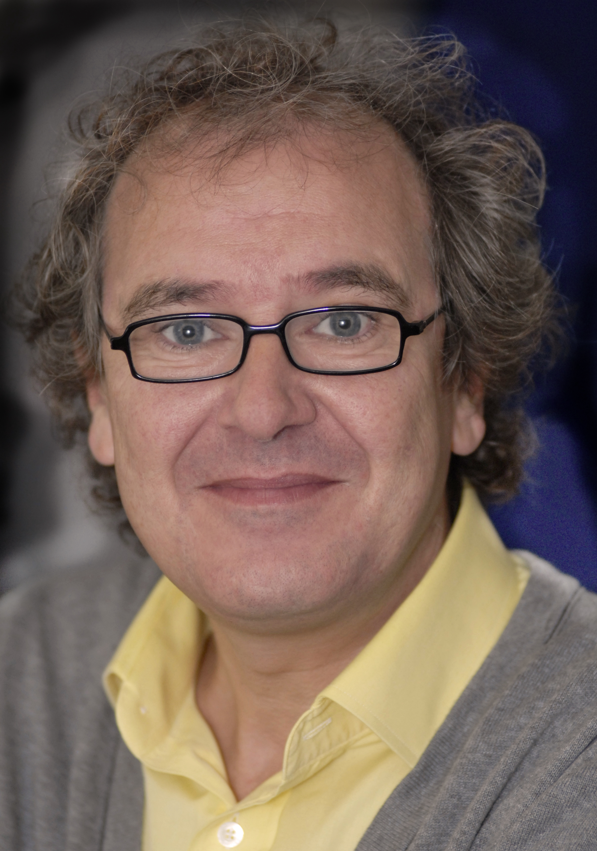
Liked using Earth Stories Film Festival e-schools resources?
We’d love to hear your thoughts, along with those of your students, about our resources. Please use the link below to send us your feedback.
Earth Stories E-school Resources Pack – Evaluation
Acknowledgements:
Special thanks goes to the following people who were instrumental in bringing together the Earth Stories Film Festival e-schools package.
      Nicola Dudley (Learning Experience Designer, Keele University)
      Aaliyah Gibbings-Gardner (Community co-ordinator, Keele University)
    James McAteer (Academic Lead for Earth Stories, Keele University)

