Slide 1

Secondary Teacher
Resource Pack

Slide 2
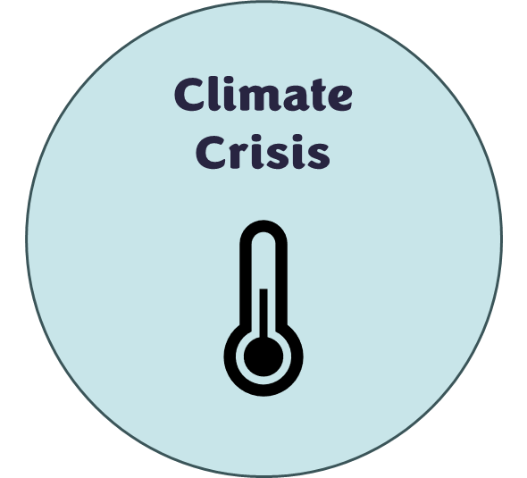
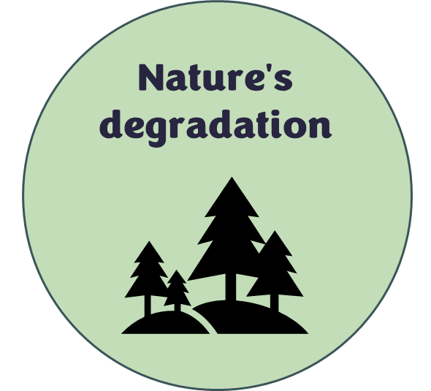

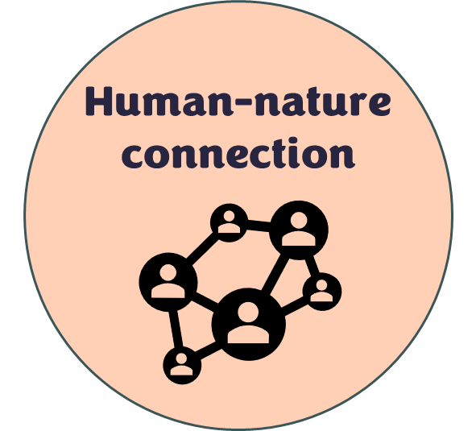

Introduction
What is Earth Stories?
Earth Stories Film Festival is an award-winning, environmental film festival providing a platform for young filmmakers under the age of 25, from across the world to articulate their concerns around the climate crisis. The festival is organised by Keele University students supported by Media staff. Earth Stories is a beacon of hope, presenting inspirational stories through the medium of film addressing the climate crisis, nature's degradation, and highlighting pathways for a more sustainable future.
Earth Stories has developed a series of lesson plans to encourage young people in the local area to think sustainably about the climate crisis, with the hope that students will take the opportunity to create a short film between 1 and 10 minutes to submit to Earth Stories Film Festival 2025 under the new category “Local Filmmaker”.
You can watch the 2025 Award Ceremony, and the nominated films from 2023, 2024 and 2025, on our YouTube channel at “Earth Stories Film Festival”.
Visit the website https://www.keele.ac.uk/earth-stories/ to find more information and links to social media channels.
About the resource pack
This pack includes lesson plans and activity sheets (including answers where necessary) for winning or shortlisted films from past festival entries.
All lesson plans include links to the English national curriculum, key vocabulary, a resource list and careers links. Links have also been made to the United Nations Sustainable Development Goals and to UNESCO’s eight key competencies for sustainability.
We have also included an Earth Guardian sticker log and certificate to encourage students to explore all the themes and create an entry for the 2026 festival. Lesson plans have been mapped to include each of the themes – look for the icons.
Advice from Explorify: ‘When teaching children about the Climate Challenge, it is important that we give them the facts (age appropriately and sensitively). During your discussions, allow time for children to express their thoughts and feelings and have them validated.’ For more information about how to teach students about the climate challenge go to Are you ready to meet the 'Climate Challenge?' Part 2 - Explorify
Tips and tricks for filming, storyboard examples and a storyboard template have also been included.
All the films in this pack can be accessed here: Primary Resource - YouTube

Slide 3
About the filmmakers
I found the Sea from the dump
Directed by Utku Alak, Cengizhan Ata Bolcan,
Age 26, Turkey.
Shortlisted submission 2023
This documentary captures the damage being done to our oceans, asking fisherman and aquaculture scientists about the causes and consequences of marine pollution and explains how this dark side of the sea was created.
Interbeing
Directed by Ben Sinclair
Age 24
United Kingdom.
Best Film Jury Award 2023
“Ben Sinclair began finding his passion for animation whilst studying at Kingston University, London. Experimenting with painterly and organic hand drawn animation, he began to realise how powerful this medium can be for educating and raising awareness about environmental and animal rights issues.”
Paralysed by the enormity of climate change and the sense of powerlessness it brings, a father experiences an existential crisis. Through this process he discovers the concept of Interbeing - a philosophy that reconnects us with the natural world. This principle is vital if we are to help our environment recover and regain balance between humanity and nature. Without it, humanity will continue to take from our planet and never give back.
Forest Flavours
Directed by Rachel Priebe
Age 25
United States
Shortlisted submission 2023
“Rachel Priebe is a recent graduate of the University of Southern California who enjoys making short documentaries about nature and the power of belief systems.”
A glimpse of the life of “wild food alchemist” Pascal Baudar and his mission to change the way we look at invasive plants. This short documentary highlights an important message around human-nature reconnection and sustainable living.

Slide 4
About the filmmakers
R
I
F

Slide 5

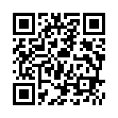
Earth Stories Film Festival
Ready to act, raise awareness about climate change and become an Earth Guardian?
Put your film making skills to the test and enter the Earth Stories Film Festival competition.
Submission deadline 16th January 2026
The following prizes will be awarded at the Earth Stories Film Festival:
Animation Award £250,
Experimental Award £250,
Documentary Award £250,
Fiction Award £250,
Young Film Award (14-16 Years old) £250,
Local Filmmaker Award (Staffordshire, Cheshire, Shropshire) £250.
More information, including terms and conditions, can be found here:
Earth Stories - Keele University

Slide 6





Become an Earth Guardian!
Complete one activity from each of the themes to become an Earth Guardian
Themes:
Collect each sticker to gain your
Earth Guardian certificate
Climate
Crisis
Nature's
degradation
Sustainable
Futures
Human-nature connection
Earth Stories
Film Festival

Slide 7
Earth Guardian Sticker Log
Sticker | Activity Completed

Slide 8

Teacher:
Name:
This certificate is awarded because an activity linked to all themes has been completed to become an Earth Guardian!
Earth Guardian
Certificate
Date:

Slide 9
Film 1: I found the sea from the dump

Slide 10
Lesson Plan Activity time: 90 minutes + This activity is designed to get students thinking about how human settlements and tourism impact the environment and how we can solve these problems.
English National Curriculum Links | KS3: Explicit links to art (use a range of techniques and media to record their observations, analyse the work of others etc), science (separating mixtures, earth's resources, recycling, food chain/web’s etc), Design Technology (identify and solve their own design problems, develop and communicate design ideas using annotated sketches etc), Geography (understand how human and physical processes interact to influence, and change landscapes, environments and the climate) can be made to this activity. Specific links will depend on the year group you aim this activity at. Whilst the current curriculum doesn’t explicitly mention climate related themes, teachers can integrate related content through cross-curricular approaches. | KS4: Explicit links to art (the ways in which meanings, ideas and intentions can be communicated through visual and tactile language etc), science (separating mixtures, earth's resources, recycling, bioaccumulation of toxins/microplastics within a food chain/web etc), Design Technology (the impact of new and emerging technologies on industry, enterprise, sustainability, people, culture, society and the environment, production techniques and systems etc), Geography (global systems & biodiversity, resources & their management etc) can be made to this activity. Specific links will depend on the year group you aim this activity at. Whilst the current curriculum doesn’t explicitly mention climate related themes, teachers can integrate related content through cross-curricular approaches.
Key Vocabulary | KS3: human settlements, tourism, microplastic/plastic, pollution, food chain, food web. | KS4: human settlements, tourism, microplastic/plastic, pollution, food chain, food web, bioaccumulation of toxins.
Resources needed | Access to internet/books, I found the sea activity sheet, Materials for prototyping (if you have time to allow students to do this), If choosing the art activity – discarded plastic in a variety of shapes, colours and sizes. Paper, pens etc. | Careers Links: A range of STEM related careers can be found here: Careers – NUSTEM Environmental scientists and marine biologists, Oceanographer, Environmental Engineers, Policy Advocates and Lobbyists.
Instructions:
Use Throw-away plastic – Explorify (start with art) as a starter activity (15 minutes).
Watch ‘I found the sea from the dump’ (8 minutes).
Discuss with students what the documentary was about (linking human settlements and tourism with pollution. Food chains and toxin accumulation (microplastics in the food that we eat). Watch the film again to aid discussions (15 minutes). This film was shot in Turkey (Eftalia Hotel, Köprüçay River, Manavgat River and Aksu River were mentioned).
Have they observed anything like this in their local area? Or experienced this on holiday?
In groups students design an innovative solution to the problem observed in the film (activity sheet included – enlarge to A3 to give more space). How can they stop pollution from entering the rivers/oceans in the first place? How can they clean up the river’s/oceans in a more efficient way? Once they have collected the plastics etc what will they do with it? How will they protect habitats/wildlife from their solution (getting caught in nets etc). Students could create a prototype of their design if time allows (50 minutes +).
Alternatively, students could create a piece of artwork using discarded plastic, with a powerful message about the plastic pollution problem.
Finish the session considering what if There was no plastic? – Explorify
Extra-curricular activities:
Encourage students to share their passion for all things climate related by creating an entry for the Earth Stories Film Festival! More information, including terms and conditions, can be found here: Earth Stories - Keele University
There are also opportunities to enter students engineering designs into National competitions, such as The Big Bang Fair Competition which aims to inspire inquisitive minds to think big, challenge facts, ask questions and invent solutions.

Slide 11
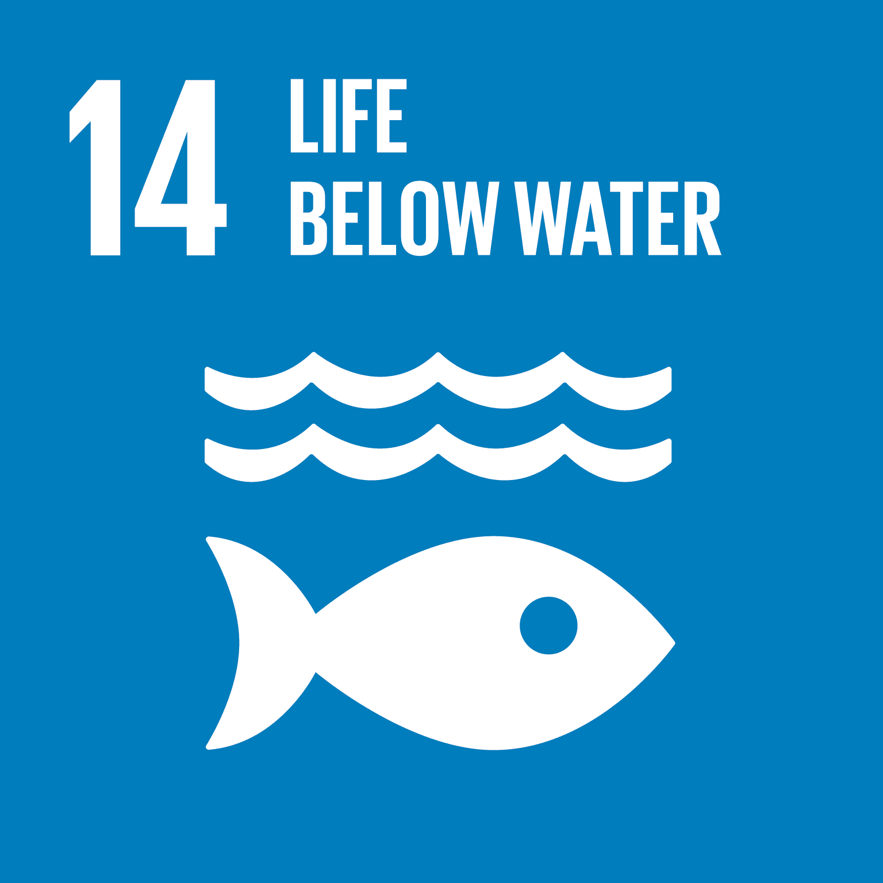


Education for Sustainable Development
`
Film: I Found the Sea from the Dump
Key Themes: Marine pollution, tourism, food chains, microplastics
Main Activities:
Watch and discuss the documentary
Reflect on local/global pollution issues
Design an innovative solution to prevent or clean up pollution
Optional: Create a prototype or artwork using discarded plastic
Use Explorify activities to explore plastic alternatives
Mapped to the United Nations Sustainable Development Goals:
 | Life Below Water – Focuses on reducing marine pollution and protecting aquatic ecosystems, which is central to the film’s message and student activities.
 | Responsible Consumption and Production – Encourages reducing plastic use and designing sustainable alternatives.
 | Climate Action – Links pollution and human activity to broader climate impacts, encouraging proactive environmental stewardship.
Mapped to UNESCO’s eight key competencies for sustainability, which are designed to equip learners with the knowledge, skills, values, and attitudes needed to contribute to sustainable development.
Systems Thinking | Students explore how pollution, tourism, and ecosystems are interconnected, especially through food chains and bioaccumulation.
Critical Thinking | Learners evaluate real-world environmental problems and assess the effectiveness of different solutions.
Strategic | Students design and propose innovative, practical solutions to reduce or manage pollution.
Integrated Problem-Solving | Combines knowledge from science, geography, and design to address complex sustainability challenges.

Slide 12
I found the Sea Activity Sheet
Your challenge:
Design an innovative solution to solve the problems you observed in the film. You could try to tackle all the issues you encountered or just focus on one:
Tourism negatively impacting the environment (tourists not using litter bins),
Waste entering streams/rivers/oceans,
Removing waste from streams/rivers/oceans,
Protecting ecosystems/habitats/wildlife,
Microplastics/toxins entering the food chain,
What to do with the waste once it has been removed.
Did you know more than 171 trillion pieces of plastic are now estimated to be floating in the world's oceans?
The problem/s I am aiming to solve:
Design Ideas:
Explain how your design will solve the problem you chose (think of the science behind your solution):
Explain how your design will protect ecosystems/habitats/wildlife:

Slide 13
Film 2:
Interbeing

Slide 14
Lesson Plan Activity time: 90 minutes + This activity is designed to get students thinking about the importance of human's connection with nature in the fight against climate change.
English National Curriculum Links | KS3: Explicit links to PHSE (mental wellbeing, physical health and fitness, health and prevention), music (play and perform confidently, improvise and compose, listen with increasing discrimination) and PE (perform dances using advanced dance techniques within a range of dance styles and forms) can be made to this activity. Specific links will depend on the year group you aim this activity at. Whilst the current curriculum doesn’t explicitly mention climate related themes, teachers can integrate related content through cross-curricular approaches. | KS4: Explicit links to PHSE (mental wellbeing, physical health and fitness, health and prevention), music (musical elements, contexts and language, perform, compose and appraise) and PE (develop their technique and improve their performance, evaluate their performances) can be made to this activity. Specific links will depend on the year group you aim this activity at. Whilst the current curriculum doesn’t explicitly mention climate related themes, teachers can integrate related content through cross-curricular approaches.
Key Vocabulary | KS3: connection, nature, anxiety, climate change, mental health, interbeing, wellbeing. | KS4:connection, nature, anxiety, climate change, mental health, interbeing, wellbeing.
Resources needed | Access to books/internet, Access to outside space – this doesn’t have to be a woodland/forest. Any environment will provide opportunities for students to discuss what the hear. If they hear nature, how does it make them feel? If they don’t, why don’t they? What can be done about it? Recording devices, Musical instruments, Space for dance practice and performance. | Careers Links: Louis VI - Rewild Yourself - Musician, Filmmaker, Zoologist, and Nature Presenter. A range of STEM related careers can be found here: Careers – NUSTEM Communication specialist, Environmental educator, Restoration Ecologist, Policy Advocate, Climate Scientist.
Instructions:
Watch ‘Interbeing’ (5 minutes).
Discuss with students what the film was about (loss of connection with nature, anxiety around the effects of climate change, mental health effects, reconnecting with nature, wellbeing). Watch the film again to aid discussions (15 minutes).
Watch BBC iPlayer - Springwatch - 2024: Episode 4, (22:28 to 32:10) – zoologist & musician (Louis VI) encourages you to stop and listen to the sounds of wildlife (10 minutes). If time allows students could explore Louis' website for more information and to watch/listen to his material.
Take your students outside to listen to the sounds of nature or forest bathe. Can they hear the sounds of nature? Why? What is their environment like? How could it be improved? What are the benefits of growing a connection with nature? 20 minutes.
If possible, students could record the sounds they hear and then use them to create a song. If recording equipment is not available students could write the lyrics and then use instruments or an AI tool such as Suno or Udio to create the music. 40 minutes +.
Other Suggestions:
Students could explore the concept of ‘rewilding’ humans. This intriguing concept encourages us to reconnect with our natural roots and rhythms. Here are some ideas to explore: exposing the body to natural light cycles (lighting to accompany their song), and physical activity that mimic our ancestors' movements (could perform a dance to go along with their song),
Wildlife Trust 30 days wild Challenge runs in the month of June. There are resources such as mindful colouring, mini-beast spotter, sensory bingo, take action for nature etc to access outside of the challenge month.
Extra-curricular activity – encourage students to share their passion for all things climate related by creating an entry for the Earth Stories Film Festival! More information, including terms and conditions, can be found here: Earth Stories - Keele University

Slide 15

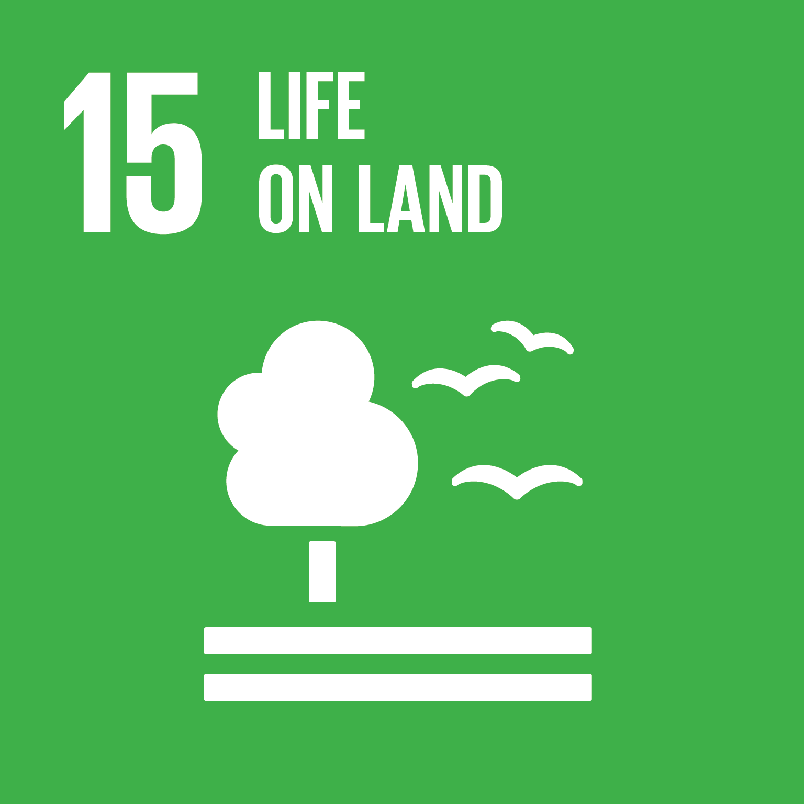
Education for Sustainable Development
`
Film: Interbeing
Key Themes: Climate anxiety, human-nature connection, mental health, wellbeing
Main Activities:
Watch and discuss the film
Explore nature-based mindfulness (e.g., forest bathing, sound walks)
Create a song using natural sounds or write lyrics
Optional: Explore “rewilding humans” through movement or dance
Engage with the Wildlife Trust’s “30 Days Wild” challenge
Mapped to the United Nations Sustainable Development Goals:
 | Good Health and Well-being - Emphasises the mental health benefits of connecting with nature and managing climate anxiety.
 | Climate Action – Encourages emotional and philosophical engagement with climate issues, fostering a sense of responsibility.
 | Life on Land - Promotes reconnection with and protection of natural environments through sensory and creative experiences.
Mapped to UNESCO’s eight key competencies for sustainability, which are designed to equip learners with the knowledge, skills, values, and attitudes needed to contribute to sustainable development.
Anticipatory | Students consider the long-term impacts of food waste and how sustainable practices can shape the future.
Normative | Reflects on values related to food justice, sustainability, and ethical consumption.
Strategic | Learners design and evaluate practical solutions to reduce food waste and promote sustainability.
Critical Thinking | Encourages analysis of food systems and challenges assumptions about waste and value.

Slide 16
Film 3:
Forest Flavours

Slide 17
Lesson Plan Activity time: 120 minutes This activity is designed to get students thinking about how we can use the connection between humans and nature to combat food waste and food poverty.
English National Curriculum Links | KS3: Explicit links to PHSE (mental wellbeing, physical health and fitness, health and prevention) and Design (Food) Technology (test, evaluate and refine their ideas; understand the source, seasonality and characteristics of a broad range of ingredients)can be made to this activity. Specific links will depend on the year group you aim this activity at. Whilst the current curriculum doesn’t explicitly mention climate related themes, teachers can integrate related content through cross-curricular approaches. | KS4: Explicit links to PHSE (mental wellbeing, physical health and fitness, health and prevention) and Design (Food) Technology (the impact of food and food security on the environment, local and global markets and communities; explain, justify and present their ideas about their chosen recipes and cooking methods to others) can be made to this activity. Specific links will depend on the year group you aim this activity at. Whilst the current curriculum doesn’t explicitly mention climate related themes, teachers can integrate related content through cross-curricular approaches.
Key Vocabulary | KS3: fermentation, foraging, surplus, food waste, food poverty, sustainable. | KS4: fermentation, foraging, surplus, food waste, food poverty, sustainable.
Resources needed | Access to internet/books, Cooking utensils & equipment, Students will need to bring their chosen food waste challenge ingredients (depending on your procedures for supporting students with this), Camera – to take photos of the final dishes. | Careers Links: Find out more about Pascal Baudar - Wild Food Artist / Traditional Food Preservation Community Growing Programme Lead, Community Gardner, Project Support Officer, A range of STEM related careers can be found here: Careers – NUSTEM
Instructions:
Watch ‘Forest Flavours’. 5 minutes.
Discuss with students what the film was about (fermentation of plants, foraging, knowing the value of plants/organisms, wild craft, food waste/poverty). Watch the film again to aid discussions (15 minutes).
Set the ‘MasterChef’ style challenge – create a dish using food waste (vegetable peel, stale bread, banana’s) surplus (apples, bananas, lots of fruit around harvest time) or leftovers from a meal (left over curry, roast chicken, cooked vegetables, rice, pasta).
Students research which are the most wasted food in the UK. Also think about their own homes and what regularly gets thrown away. 15 minutes.
Design a dish using their selected discarded, surplus or leftover foods, explaining why they have chosen them. 15 minutes.
Could watch BBC One - MasterChef, Series 19, Episode 11 (1:30-28:30) for inspiration.
Create/cook the dish, followed by tasting and evaluation. 60 minutes.
Extra-curricular activities:
If your risk assessments allow, take the students foraging for foods and then use these to create a dish.
Encourage students to share their passion for all things climate related by creating an entry for the Earth Stories Film Festival! More information, including terms and conditions, can be found here: Earth Stories - Keele University

Slide 18

Education for Sustainable Development
`
Film: Forest Flavours
Key Themes: Food waste, foraging, sustainability, food poverty
Main Activities:
Watch and discuss the film
Research most wasted foods in the UK
Design and cook a dish using food waste, surplus, or leftovers
Optional: Foraging activity or food preservation exploration
Evaluate and present their culinary creations
Mapped to the United Nations Sustainable Development Goals:
 | Zero Hunger - Addresses food insecurity and encourages creative use of surplus and waste to reduce hunger.
 | Responsible Consumption and Production – Promotes sustainable food practices and reduces waste through practical, hands-on learning.
 | Life on Land - Encourages sustainable use of natural resources and appreciation of wild, foraged foods.
Mapped to UNESCO’s eight key competencies for sustainability, which are designed to equip learners with the knowledge, skills, values, and attitudes needed to contribute to sustainable development.
Systems Thinking | Students explore how pollution, tourism, and ecosystems are interconnected, especially through food chains and bioaccumulation.
Critical Thinking | Learners evaluate real-world environmental problems and assess the effectiveness of different solutions.
Strategic | Students design and propose innovative, practical solutions to reduce or manage pollution.
Integrated Problem-Solving | Combines knowledge from science, geography, and design to address complex sustainability challenges.

Slide 19
Earth Stories Food Waste Challenge
Your challenge:
Design and create a mouth-watering dish using:
Food waste (vegetable peel, stale bread, bananas),
Surplus food (apples, bananas, lots of fruit around harvest time), or
Leftovers from a meal (left over curry, roast chicken, cooked vegetables, rice, pasta).
Step 1: find out which are the most wasted food in the UK. Also think about food waste at home and what regularly gets thrown away.
Step 2: Design a dish using your selected discarded, surplus or leftover foods, explaining why you have chosen them. Remember to include an ingredients list (including amounts using the correct unit; g, kg, ml etc).
Step 3: Create/cook the dish, followed by tasting and evaluation.
Did you know the UK throws away around 9.5 million tonnes of food waste every year? That’s enough to feed 30 million people a year!
In the UK, the following foods are regularly surplus to requirements, leftover or thrown away:
Recipe design ideas:
Ingredients & Equipment list:
I have chosen these ingredients because. . .

Slide 20
Earth Stories Food Waste Challenge continued
Method:
Final creation (stick a photograph here or draw a picture):
Evaluation:
1. Things that went well:
2. Did you manage to complete the challenge? Did you find this difficult? Why?
3. Things you could do to improve:

Slide 21
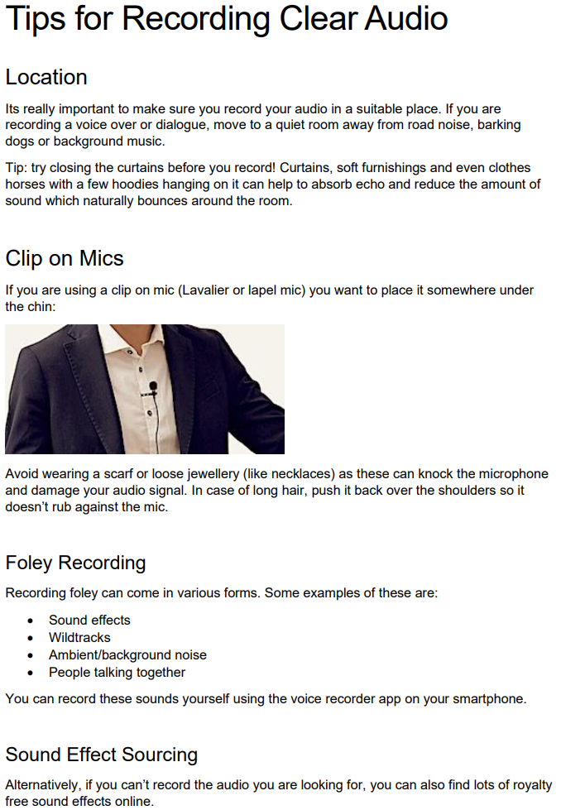
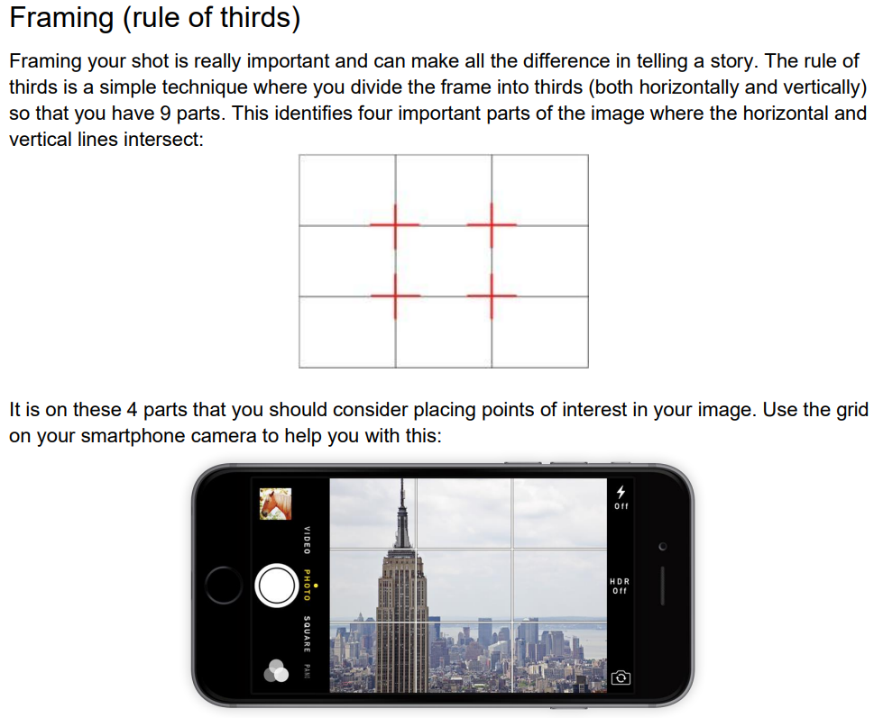
How to make a short film
Tips and Tricks
The BBC have some great advice on how to film:
How to Film: Basic - BBC Bitesize
How to Film: Advanced - BBC Bitesize
How to edit: Basic - BBC Bitesize
How to Edit: Advanced - BBC Bitesize
There is also a parent/carers guide to help support children: How to help your child make a film at home - Parents Toolkit - BBC Bitesize
Sam Galantini - 2023
Some other helpful links:
More Great tips on shooting on your phone: https://teltblog.uclan.ac.uk/2020/01/27/five-tips-for-filming-with-a-mobile-phone/
Shoot Professional Videos with an Android Smartphone https://youtu.be/8YiwBsTQ_c0
Advanced smartphone shooting tips: https://www.pocket-lint.com/phones/news/131351-10-tips-for-recording-better-video-with-your-smartphone

Slide 22
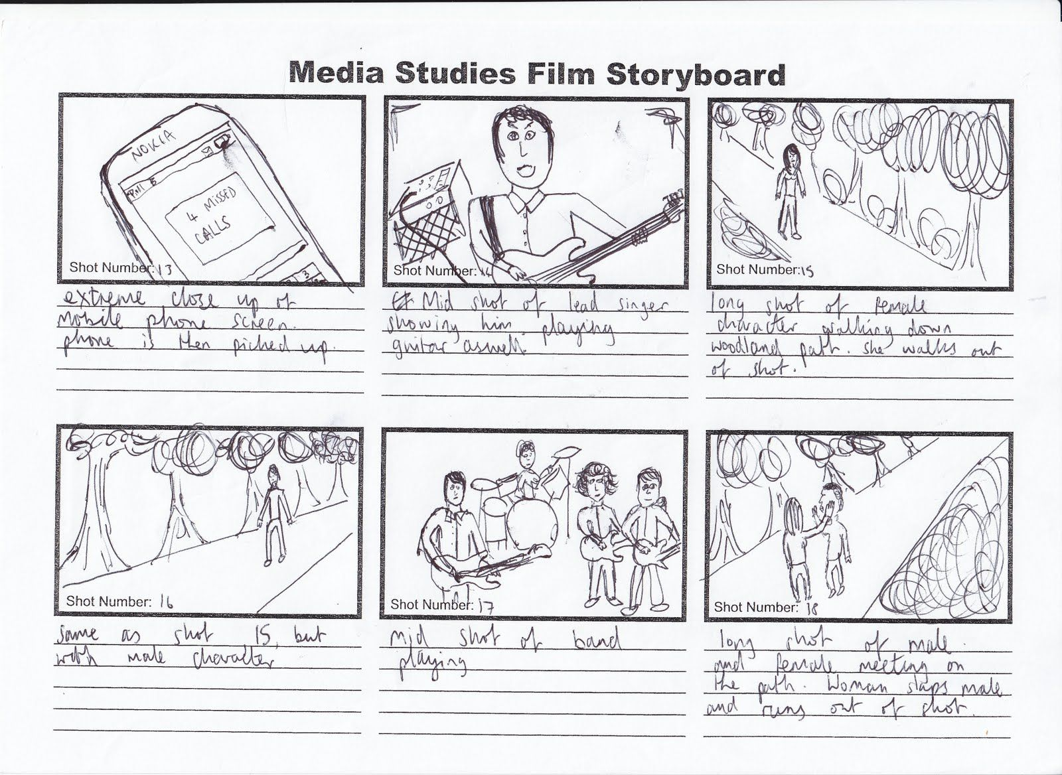
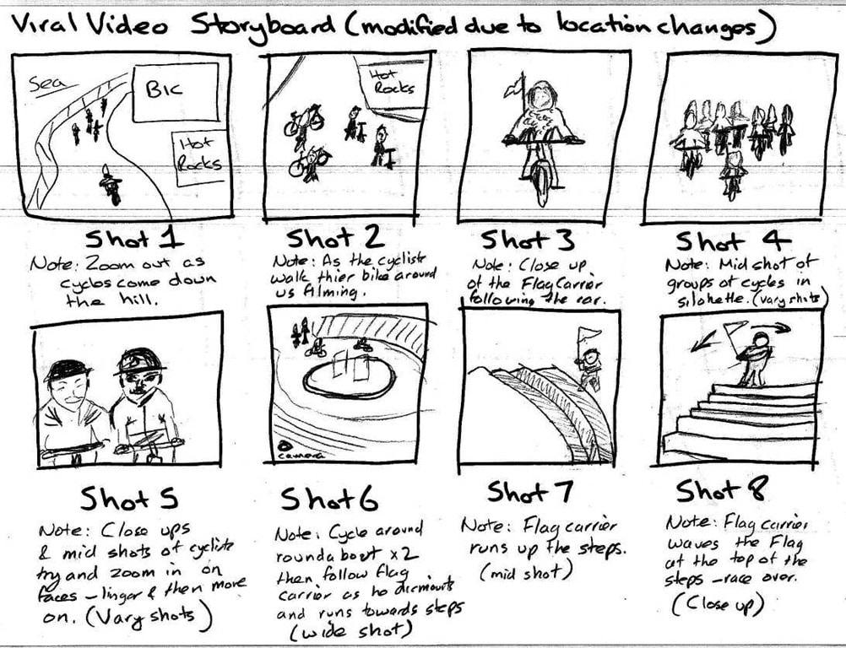
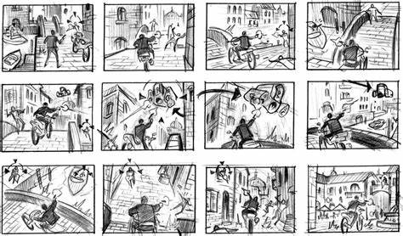
Storyboard Examples
Credit to:
krismediank.blogspot
Credit to:
trainingforgold.eu
Zhang Eliot (Pintrest)

Slide 23
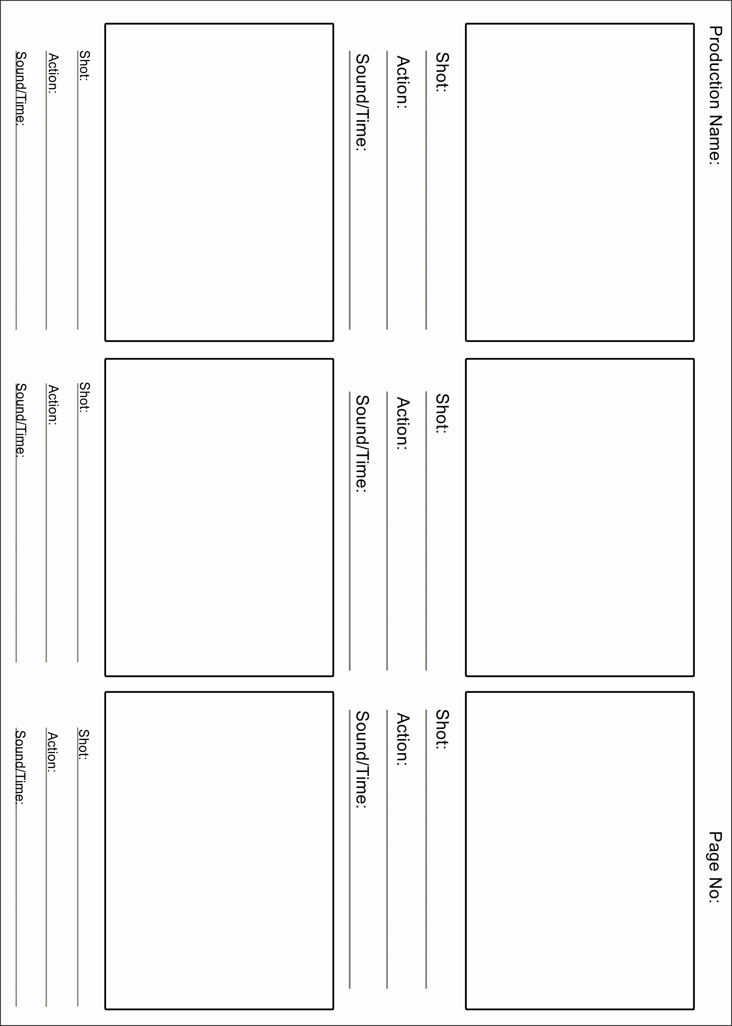
Storyboard Template
Template from: https://leonwebster.z19.web.core.windows.net/story-board-template-pdf.html

Slide 24

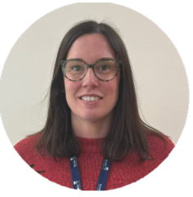
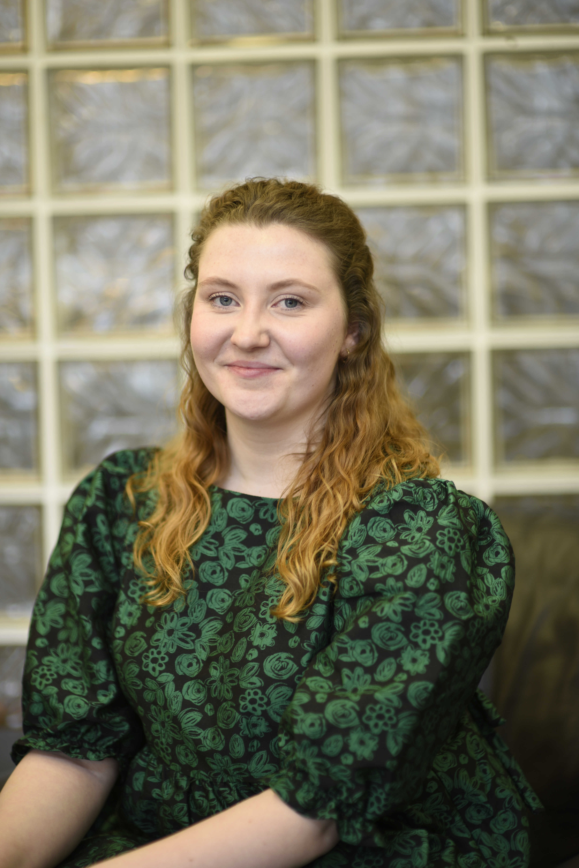
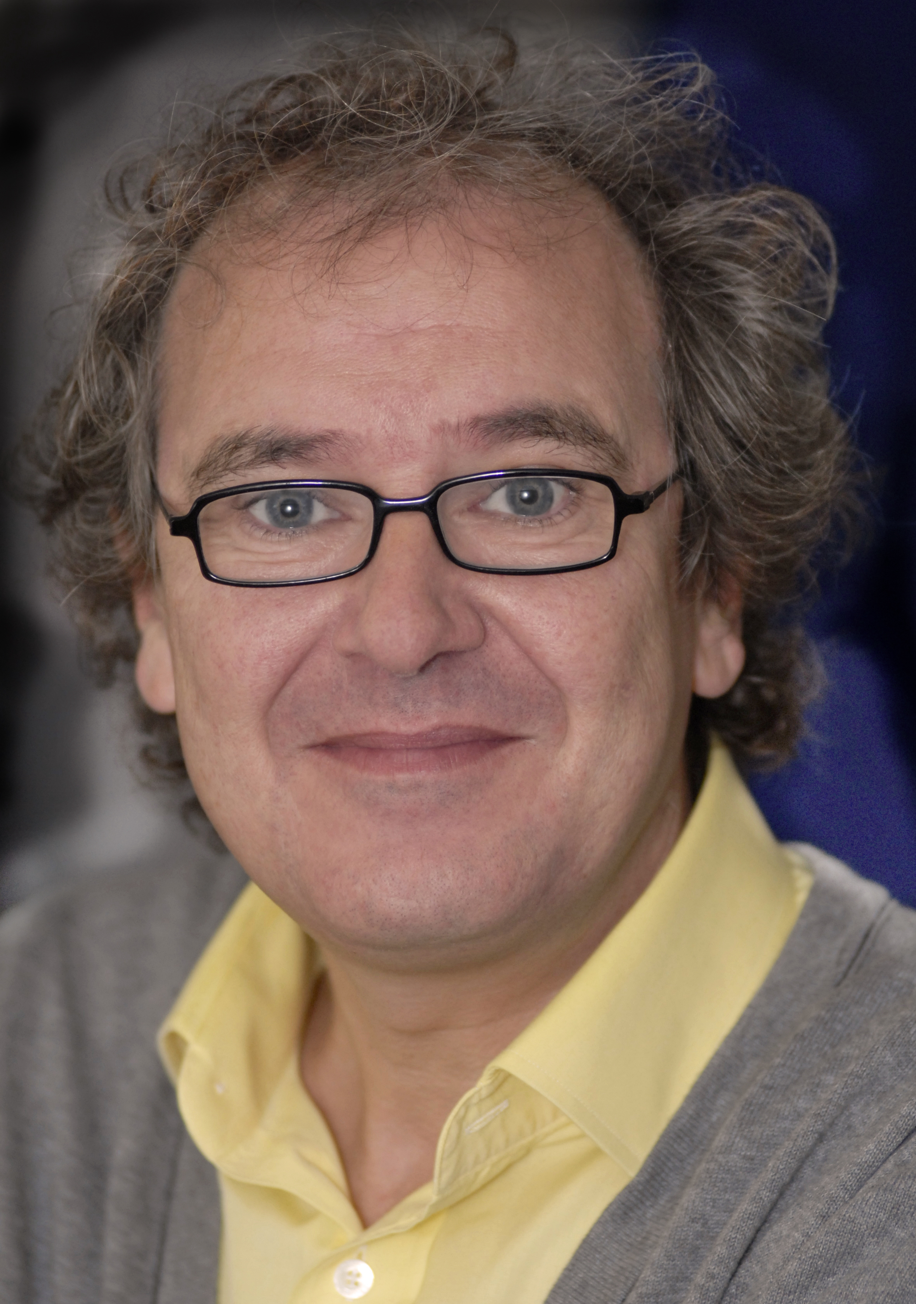
Liked using Earth Stories Film Festival e-schools resources?
We’d love to hear your thoughts, along with those of your students, about our resources. Please use the link below to send us your feedback.
Earth Stories E-school Resources Pack – Evaluation
Acknowledgements:
Special thanks goes to the following people who were instrumental in bringing together the Earth Stories Film Festival e-schools package.
Nicola Dudley (Learning Experience Designer, Keele University)
Aaliyah Gibbings-Gardner (Community co-ordinator, Keele University)
James McAteer (Academic Lead for Earth Stories, Keele University)

